Slide 1
AALC Budget and Finance Q & A
Office of the Controller/Budget Office

Slide 2
Workshop Presenters
Debra Glenn
Assistant Vice President for
Business Services/Controller
801-957-4084
Debra.Glenn@slcc.edu
Travis Kartchner
Associate Controller/Treasurer
801-957-4224
Travis.Kartchner@slcc.edu
Sean Clayton
Assistant Controller
801-957-4676
Sean.Clayton@slcc.edu
Ben Booth
Assistant Controller
801-957-4223
bbooth7@slcc.edu
Brandon Thomas
Director, Purchasing & Accounts Payable
801-957-4255
Brandon.Thomas@slcc.edu
Michelle Cahoon
Senior Accountant
801-957-4656
Michelle.Cahoon@slcc.edu
Brooke Jensen
Internal Controls Analyst
801-957-5837
Brooke.Jensen@slcc.edu
Jillana AhLoe
Budget Director
801-957-4149
jillana.ahloe@slcc.edu

Slide 3
BCM Basics
A Budget Center Manager (BCM) is a special designation that means acceptance of financial empowerment and accountability.
Generally, only administrator/manager level positions are BCMs.
BCMs act prudently in ALL financial matters to protect College interests.
BCM accountability cannot be delegated, but Administrative Assistants assist the BCM in fulfilling their role by performing financial related tasks.
BCM financial duties and responsibilities (handout).

Slide 4
Budget and Business Cycle
The fiscal year generally follows the academic year.
College fiscal year is July 1 – June 30
Fiscal year 2023 (FY23): July 1, 2022 through June 30, 2023
Summer semester is split between two fiscal years.

Slide 5
Budget and Business Cycle
July Establish New Year Budgets (alpha indexes) Close Prior Fiscal Year
August - December Establish Numeric Index Budgets Strategic Planning and Prioritization
June Year-End Clean Up Deficit Remediation New Year Preparation
January - March Legislative Session & Tuition Hearings Informed Budget Process (IBP)
April – May IBP Executive Cabinet Review and Final Decisions Purchasing Deadline

Slide 6
Budget Creation and Disbursement
Appropriated Funds
Other Funds
Generally ALPHA indexes
Approved by Cabinet
Established by the Budget Office
Generally NUMERIC indexes
Fee based
Sales
Grants
Donations
Departments responsible for budget set up in August (yellow form)

Slide 7
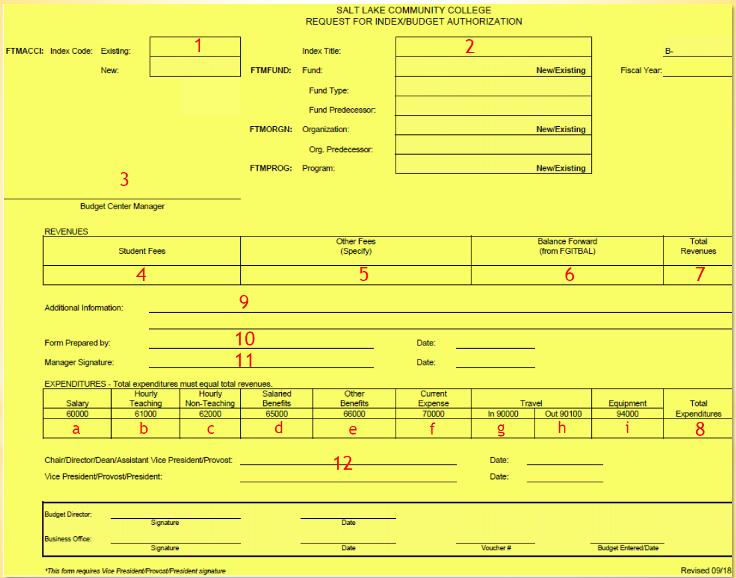
Budget Office website >>
Budget Training & Resources >>
Additional Resources >>
How to set up initial budget for self-support indexes

Slide 8
Budget and Finance Best Practices
Source and Use of Funds
Why is this important?
Journal Entries
Why?
When?
Nonsufficient Fund Flag (NSF)
When is it turned on?
Controller Memos

Slide 9
Tools
Banner
FGIBAVL
FGIBDST
FGITRND
FGIOENC
FGRODTA
Controller's Office staff
AskAController@slcc.edu
ServiceNow
SLCCBuy
Chrome River
Etrieve
Training materials
Budget Availability Report
Budget Office staff
BudgetOffice@slcc.edu

Slide 10
Checklist Handout

Slide 11
Checklist
Daily/Weekly
Login to SLCCBuy to submit or approve requisitions.
Monthly
Review FGIBAVL or Banner Budget Availability Report

Slide 12
Budget Availability Report

Slide 13
Checklist
Daily/Weekly
Login to SLCCBuy to submit or approve requisitions
Monthly
Review FGIBAVL or Banner Budget Availability Report
Review FGIBDST and FGITRND or FGRODTA
Review open encumbrance list in FGIOENC
Complete p-card expense reports in Chrome River

Slide 14
Checklist
Yearly
Set up budgets for numeric indexes only
Submit IBP requests to the IBP portal
As Needed
Request journal entries from the Controller's Office
(Can take up to 10 days)
Submit or approve budget transfers in Etrieve
(Can take up to 10 days)

Slide 15
Financial Data
What do the numbers mean?
Index Codes
Alpha (BBBOFF) - E&G Funded
Numeric – Self Sustaining
Account Codes
50000-59999 – Revenue
60000-69999 – Payroll Expenses
70000-79999 – Current Expenses
90000 – Travel Expenses
94000 – Capital Expenses (unit cost of $5,000+)

Slide 16
Financial Data
Budgets
Established on the top level account
60000 – Salaries Budget
65000 – Benefits Budget
70000 – Current Expense Budget
90000 – In State Travel Budget
94000 – Capital Expenses (unit cost of $5,000+)
Encumbrances that roll from previous fiscal year show up as budget on the same account the encumbrance is on.

Slide 17
Budget Reports
FGIBAVL – shows budget availability for an index by budget categories (for expenses only)
FGIBDST – shows budget availability for an index by accounts (for revenue & expenses)

Slide 18
FGIBAVL vs. FGIBDST
FGIBAVL
FGIBDST
Total/Summary by “Budget Roll-Up Category”
(excludes Revenue Budget category)
YTD Column
60000
62000
65000
70000 $ 6,250
90000
90100
Total/Summary info by Account #
YTD Column
70405 $ 250
70445 $ 1,500
70455 $ 100
70460 $ 2,700
73070 $ 1,000
7xxxx etc. $ 700
Total of 70000’s $ 6,250

Slide 19
FGIBAVL
Same Budget Information
FGIBDST

Slide 20
FGIBAVL
Expenses & commitments by budget category
FGIBDST
Same data but categorized by account

Slide 21
FGIBAVL
Available balances by budget category
FGIBDST
The sum of each budget with its corresponding accounts equals each available balance

Slide 22
General Accounting and Budget Forms in Banner
FGIBAVL (Budget Availability Status Form)
Displays the following information by budget category:
Budget amounts (for expense categories only)
YTD activity (posted transactions)
Commitments (unposted transactions)
Available balances
When to use it: When you need a high-level overview of how much of each expense budget you have available to spend from an index.
Form-specific things to remember:
Enter 60000 in the Account parameter.
Positive available balances are good; Negative available balances are BAD!
Exportable to Excel.

Slide 23
FGIBAVL Parameters Example

Slide 24
General Accounting and Budget Forms in Banner
FGIBDST (Organizational Budget Status Form)
Displays the following information:
Budget category amounts (for revenue & expense categories)
YTD activity (posted transactions) by account
Commitments (unposted transactions) by account
Available balances (by summing the account amounts to their corresponding budget amounts)
When to use it: When your BCM needs a high-level overview of how much of each revenue and expense budget you have available to spend from an index.
Form-specific things to remember:
After you sum the account amounts to their corresponding budget amounts, positive available balances are good; Negative available balances are BAD!
Exportable to Excel.

Slide 25
FGIBDST Parameters Example

Slide 26
General Accounting and Budget Forms in Banner
FGITRND (Detail Transaction Activity)
Displays transaction details such as: amount, transaction date, description, etc.
When to use it: When you need more details to research the amounts from FGIBDST in each account.
Form-specific things to remember:
Access FGITRND by F3
Transactions that cause revenue or expenses to grow display as increases (+) to their corresponding accounts. However, an increase in expenses reduces your budgeted expenses.
Field column
YTD = Posted transactions
OBD = Budget carryforwards
ENC = Encumbrances (Unposted transactions)
Exportable to Excel.

Slide 27
FGITRND Example

Slide 28
General Accounting and Budget Forms in Banner
FGRODTA (Organization Detail Activity)
Displays transaction details such as: amount, transaction date, description, etc. It is the same data that is shown in FGITRND but in a report-style format.
When to use it: When you would like to see transaction details for each account in a report format.
Report-specific things to remember:
How to run FGRODTA
Exportable to Word and Excel.
How to export the FGRODTA report to Excel

Slide 29
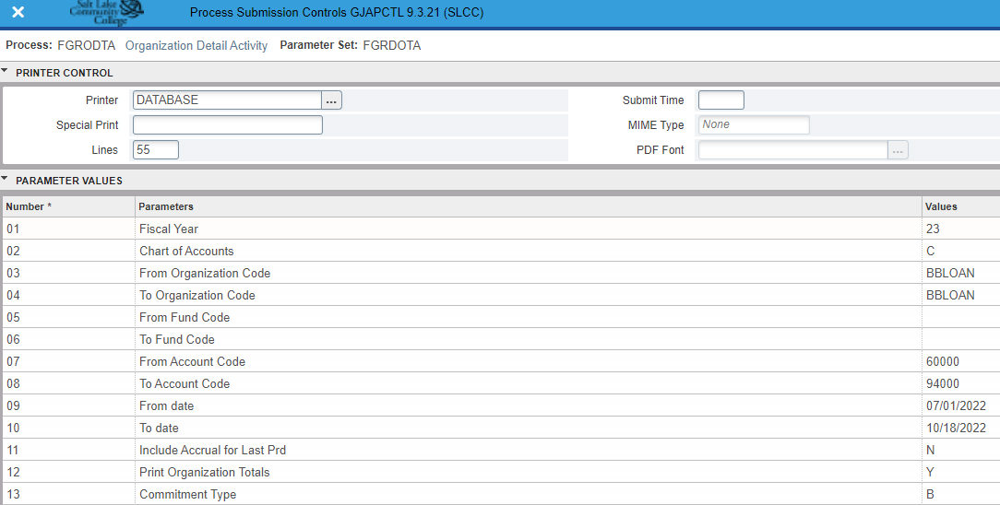
FGRODTA Parameters Example

Slide 30
General Accounting and Budget Forms in Banner
Banner Budget Availability Report (FWRBBA9)
Base budget including permanent transfers
Revised budget including temporary transfers
YTD Expenditures
Encumbrances
Available balances
When to use it: When you need a high-level overview of an index’s budgeted vs actual revenues and expenses.
Report-specific thing to remember:
Emailed to BCMs at the beginning of each month
Understanding your Banner Budget Availability Report (FWRBBA9)

Slide 31
Encumbrances
What is an encumbrance?
Reservation or commitment of funds for future payments
When is an encumbrance created?
SLCCBuy - POs that start with a ‘P’
Non-catalog items and punch-out orders where p-card is not used
P-Card orders create POs that start with a “Q” – Not Encumbered
Payment Requests create POs that are all numbers – Not Encumbered
Chrome River – Travel Pre-Approval – T numbers
When is an encumbrance liquidated/reduced or closed?
As payments are made
EOY Cleanup
Request – Order/item Canceled, final amount less than estimate
purchoff@slcc.edu

Slide 32
Encumbrances – Banner - FGITRND
Field | Type
ENC | E100 – Establish Travel Encumbrance PORD – Establish Purchase Order INEI – Invoice liquidation E032 – Final liquidation
YTD | INEI – Invoice against Encumbrance
For each invoice, there are two entries, An ENC entry to reduce the encumbrance and a YTD entry.

Slide 33
Encumbrances – Banner FGIOENC
FGIOENC (Organizational Encumbrance List)
Displays open encumbrances on an Index
When to use it: When you need more details regarding outstanding commitments
How to access it: Direct Access or through the Options menu on FGIBDST
How to use it: If using Direct Access, enter Index. If through FGIBDST, no input necessary.

Slide 34
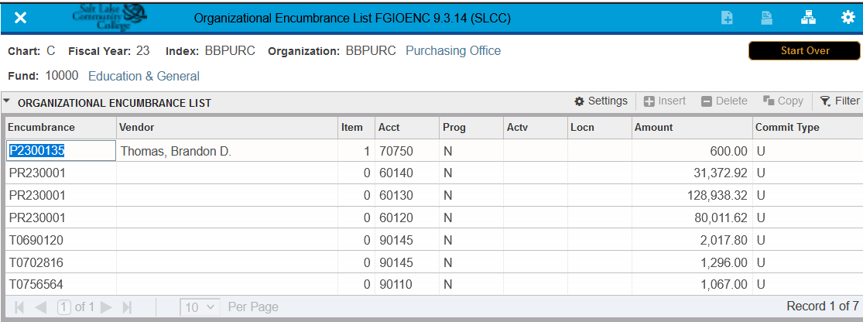
Encumbrances Banner - FGIOENC
Types of encumbrances:
P - Purchase Orders. Additional information can be found in SLCCBuy.
T – Travel. Additional information can be found in Chrome River.
PR – Payroll.

Slide 35
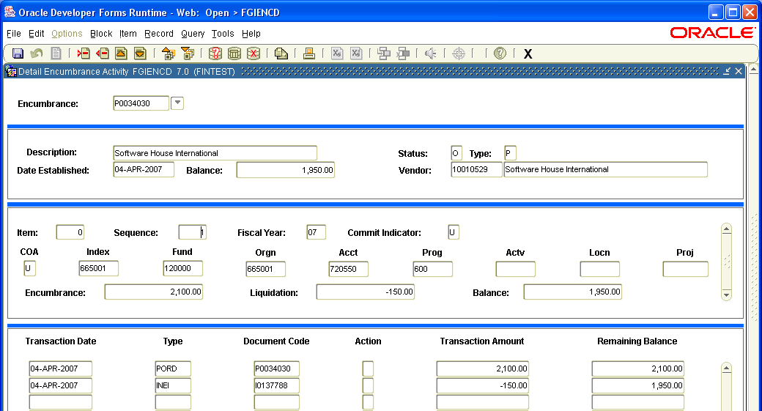
Encumbrances Banner - FGIENCD
FGIENCD (Detail Encumbrance Activity)
Displays encumbrance activity
When to use it: When you need more details regarding a specific encumbrance
How to access it: Direct Access or through the Options menu on FGIOENC
How to use it: If using Direct Access, enter the encumbrance number. If through FGIOENC, no input necessary.
Each transaction effecting the encumbrance is listed at the bottom of the form, including adjustments and invoices/payments. Note there may be multiple lines/items on a single encumbrance. You can scroll through each item by using the arrow keys on the keyboard.

Slide 36
Encumbrances Banner – Encumbrance Roll
What is the Encumbrance Roll
Encumbrances created in one FY that will not be paid until the next FY.
Both the encumbrance and the budget is rolled.
Occurs around July 15th.
Details regarding rolled encumbrances can be found on FGIOENC.

Slide 37
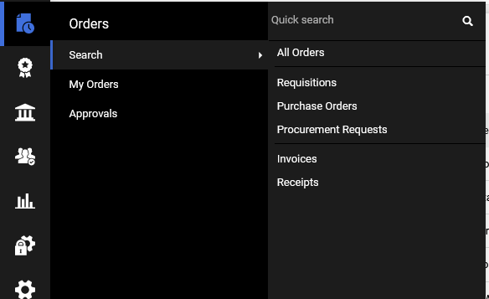
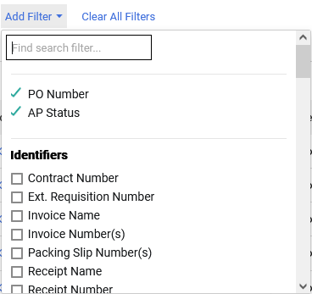
Encumbrances - SLCCBuy
List all Purchase Orders for department.
To list Purchase orders for a single Index, add Index as a filter.

Slide 38
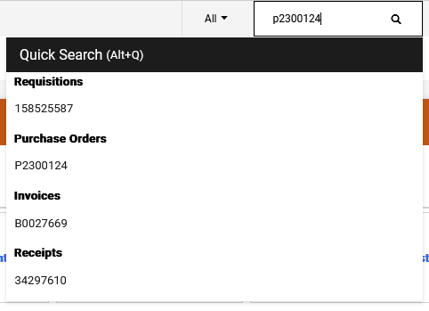
Encumbrances - SLCCBuy
Direct access to a PO
Enter PO number in Quick Search at the top
All documents related to the PO will be displayed.
Click on the Purchase Order number.

Slide 39
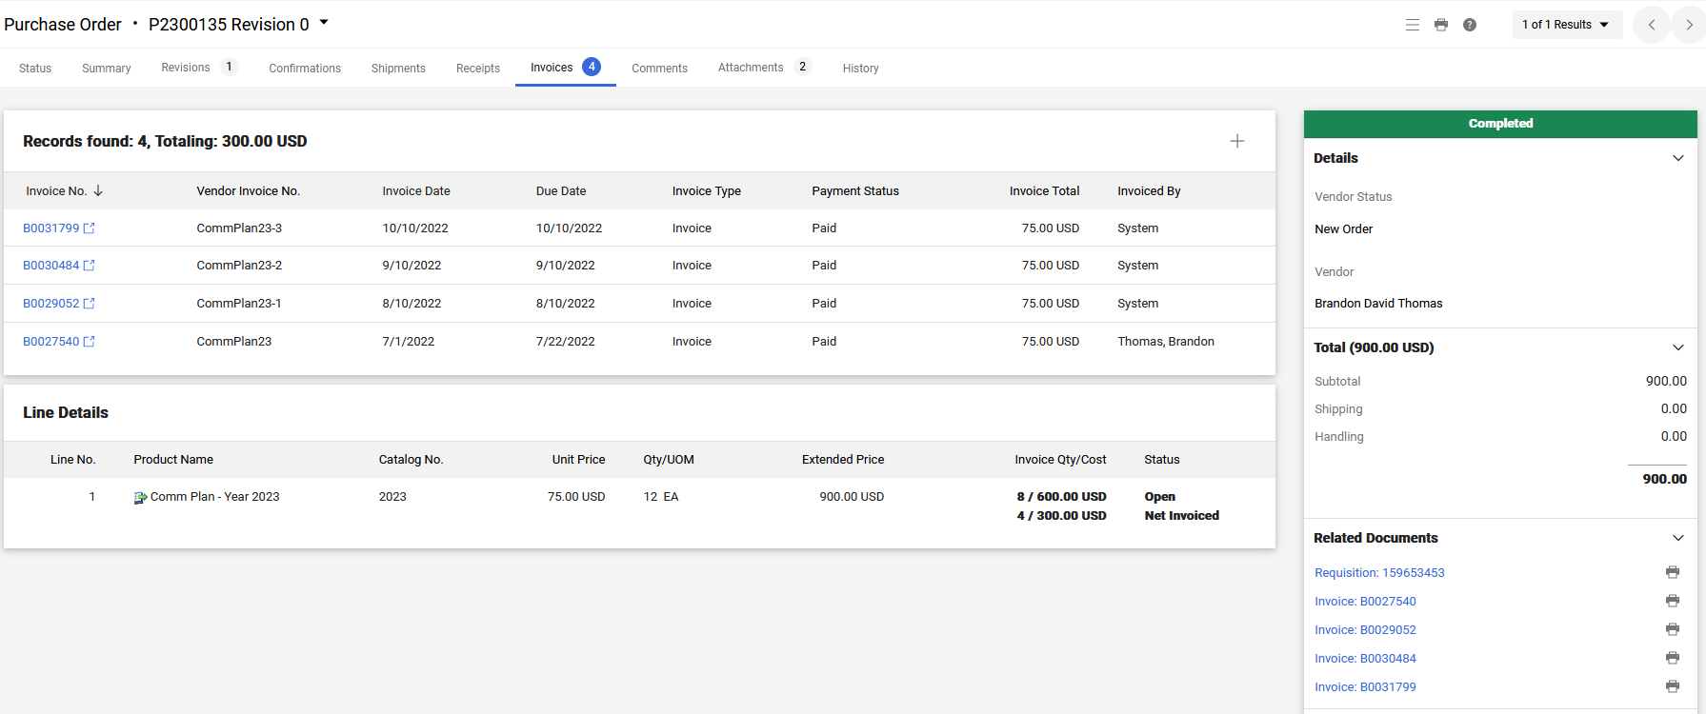
Encumbrances – SLCCBuy
Invoice tab will list all invoices entered on the PO.
Under Line Details
Open – amount remaining
Net Invoiced – amount paid

Slide 40
Future Trainings
Budget & Finance Forum
As needed
Biannual BCM and Administrative Assistant Training
Fall and Spring
Banner Deep Dive
Spring (Generally April or May)

Slide 41
Questions?

