Slide 1
Senior Leadership Retreat
July 11, 2019
SLCC Pathways

Slide 2
Market Research – Fall ‘18/Spring ‘19
Students (current and prospective)
Prospective traditional, n = 203
Current traditional, n = 318
Current non-traditional, n = 337
Parents (n = 30)
High School Counselors (n = 6)
Murray, Bingham, Valley, Herriman, Copper Canyon, Brighton

Slide 3
Big Picture
The concept of Pathways is positively received, but
there is no need to introduce it as a new initiative
Simplicity and clarity drive interest
Perceived inflexibility is the main concern
Needs for communication and information are high
Career-based outcomes are important for all groups

Slide 4
Big Picture
Students want to be guided, have a clear outline and know exactly what they need to do to finish
Students care first about finding a major they are passionate about, then focus on career projections, transferring, finishing quickly, etc.
Students want to explore, but they also want a default course map if they choose to use it
Students identify with the word “major”

Slide 5
Recommendations
Use the words “guided” or “individualized” or
“intentional exploration”
Use “undecided,” “degree” and “major”
Include info on requirements and cost
Emphasize a simplified process and the support
SLCC provides
Address flexibility

Slide 6
For the complete study:
http://i.slcc.edu/plan/resources.aspx

Slide 7
SLCC Pathways
People are not aware of their own needs and preferences
Even when they are, don’t have unlimited time or capacity to research available options
Easiest decision is not deciding (decision deferral)
Judith Scott-Clayton
“The Shapeless River: Does a Lack of Structure Inhibit Students’ Progress at Community Colleges?”

Slide 8
SLCC Pathways
SLCC Pathways provides a guided program of study intentionally designed to enhance learning and clarify a student’s route to program completion, a career, and further education

Slide 9
SLCC Pathways
Enhance learning
Guide Students
Assessment
Case Management Advising
Curriculum
Orientation
High-impact Teaching
Career Services
Learning Climate
Application

Slide 10
SLCC Pathways
Enhance learning
Guide Students
Assessment
Case Management Advising
Curriculum
Orientation
High-impact Teaching
Career Services
Learning Climate
Application

Slide 11
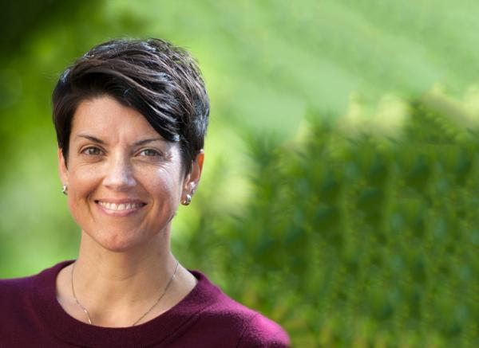
Enhance learning
Campuses need to make commitments to student engagement with experiences that are connected over time, where engagement is pervasive and expected and doesn’t take the form of a “one off” experience.
-Dr. Ashley Finley
Associate Vice President for Academic Affairs and Dean of the Dominican Experience at Dominican University of California
From: Jankowski, Natasha A.. Degrees That Matter: Moving Higher Education to a Learning Systems Paradigm . Stylus Publishing. Kindle Edition.
Notes:
In a commentary piece regarding national evaluations of student success projects, Ashley Finley (2016) looked across the various findings and concluded that Campuses need to make commitments to student engagement with experiences that are connected over time, where engagement is pervasive and expected and doesn’t take the form of a “one off” experience.
Thus, it is not enough for institutions of higher education to offer students the opportunity to participate in such activities; they need to be an integral part of the lived educational experience of all students in order to see the highest impacts.

Slide 12
Curriculum
Instruction
What we teach
How we teach
Framework for Coherence
Assessment
Learning Climate
Ensuring students learn
How students experience our teaching

Slide 13
Intrusive Case-management Advising
5 Milestones
1
2
3
4
5
Getting Ready and Registering
Goal Setting and Degree Planning
Transfer and Career Planning
Preparing to Graduate
Preparing to Work
Before 1st Day of Class
Before end of 1st Semester
Before 50% Program Completion
Before 75% Program Completion
Before 100% Program Completion
Hold Placed
Hold Placed
Other additional meetings as needed for early alert or other needs

Slide 14
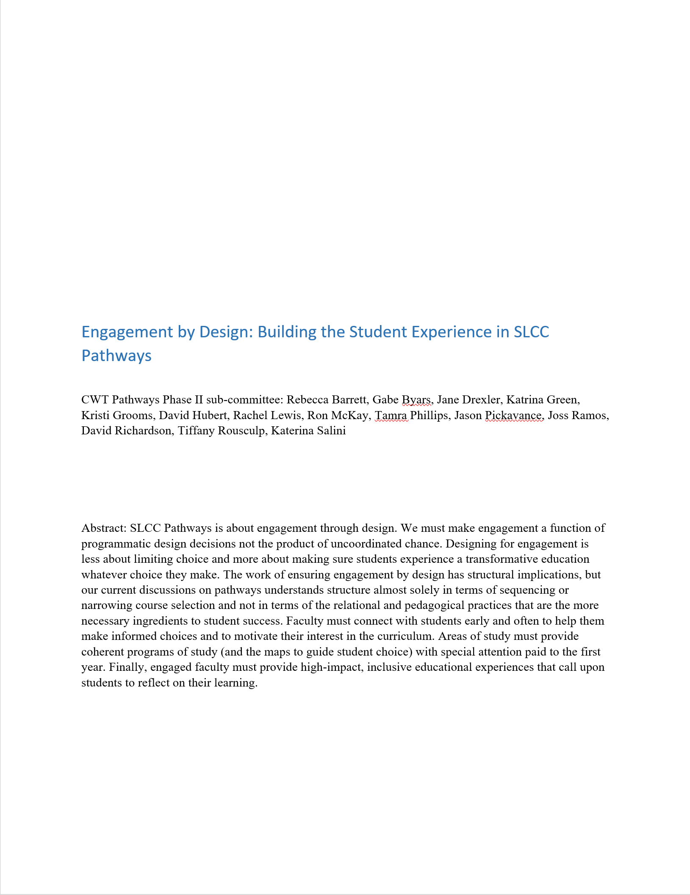
Engagement by Design
Eleven design principles to build authentically integrated programs.
Notes:
Principles for Area of Study Design
Faculty and curriculum are essential in helping inform and connect students to an Area of Study as an early part of their educational experience.
Students need to understand the overall organization and goals of a Program.
Students need effectively designed maps in order to make good choices
A student's first year should prepare her to enter any program within the area of study
Students should not be penalized for changing an Area of Study within their first year
General education should be distributed across many disciplines.
Curricular and program development should be based on the program, not individual courses.
Students learn better when they reflect on their educational experiences.
High-impact teaching practices improve student persistence and retention.
Students are more likely to persist in inclusive, diverse, and accessible learning environments.
Faculty are better teachers when they are supported and passionate about what they do.
DEVELOPED BY Facutly

Slide 15
Curriculum
Instruction
What we teach
How we teach
Framework for Coherence
Assessment
Learning Climate
Ensuring students learn
How students experience our teaching

Slide 16
Area of Study Design Team
Science, Engineering, and Math
Pathways CWT
Area of Study Design Team
Manufacturing, Construction, and Applied Technologies
Executive Sponsors: Provost & VP Student Affairs
CWT Lead: Senate President & AVP Student Success
Membership
Curriculum Committee Chair
General Education Committee Chair
Associate Vice President for Enrollment Management
Faculty Development Director
Design Team Co-Leads (Dean/AD & Faculty)
Arts, Communication, and Digital Media
Business
Computer Science & Information Technology
Health Sciences
Humanities
Manufacturing, Construction, and Applied Technologies
Science, Engineering, and Math
Social and Behavioral Sciences, Education, and Human Services
General Education
Area of Study Design Team
Social and Behavioral Sciences, Education, and Human Services
Area of Study Design Team
Business
Area of Study Design Team
Arts, Comm, and Digital Media
Area of Study Design Team
Humanities
Area of Study Design Team
Computer Science & Information Systems
Area of Study Design Team
Health Sciences
General Education Design Team

