Slide 1
Salt Lake Community College
Pathways Implementation Messaging Strategy
May 2019

Slide 2
Agenda
4 | Background, Objectives, and Methodology
7 | Executive Summary and Strategic Recommendations
21 | QUANTITATIVE INSIGHTS – STUDENT SURVEY
 | Academic Terminology Used
 | Student Decision-Making Process
 | College Attribute Importance
 | Introduction to Pathways
 | Pathways at SLCC
60 | QUALITATIVE INSIGHTS
 | Parent Focus Groups
 | High School Counselor Interviews
86 | Appendix

Slide 3
Agenda
4 | Background, Objectives, and Methodology
7 | Executive Summary and Strategic Recommendations
21 | QUANTITATIVE INSIGHTS – STUDENT SURVEY
 | Academic Terminology Used
 | Student Decision-Making Process
 | College Attribute Importance
 | Introduction to Pathways
 | Pathways at SLCC
60 | QUALITATIVE INSIGHTS
 | Parent Focus Groups
 | High School Counselor Interviews
86 | Appendix

Slide 4
Background and Objectives
Background
Salt Lake Community College (SLCC) is planning to implement a pathways model as it seeks to continue to innovate and improve its educational offerings. Given that this represents a significant paradigm shift to a model unfamiliar to a range of key constituent populations, SLCC wants to understand how it can best implement it with minimal disruption to the current student body, while also effectively messaging the benefits and innovative aspects of this model to current students, prospective students, and influencers of prospective students (namely, parents and high school counselors). SLCC also needs to understand how it can best address common concerns and what critical information will need to be disseminated prior to the transition to the new model.
Objectives
Evaluate various messaging strategies and options to understand which resonate well and which most optimally and impactfully portray the benefits and key differences of the pathways program to stakeholder audiences, with particular focus on prospective and current students
Identify and understand key concerns associated with this program among each audience, and understand how and what information/resources will be needed to effectively address those concerns
Understand the impact of the transition on current students, both those who are traditional and those who are non-traditional, and identify what information will need to be disseminated prior to the transition to avoid student confusion and/or dissatisfaction
Understand the key differences in messaging and information needs between traditional and non-traditional students, as well as between students and their influencers

Slide 5
Methodology
High School Counselors
Parents
Prospective / Current
Students
QUALITATIVE RESEARCH
In-depth interviews to discover factors that contribute to school and degree decisions, respondents’ reaction to the pathways model, and the terminology used to describe and message the model.
n = 6
Length of interview: 30 min
Interview dates:
Oct. 22, 2018 – Nov. 2, 2018
High school counselors interviewed:
Murray
Bingham
Valley
Herriman
Corner Canyon
Brighton
QUALITATIVE RESEARCH
Focus groups with parents of children between the ages of 16 – 24 who indicated they would be willing to have their son or daughter attend Salt Lake Community College and who come from a variety of educational, economical, and professional backgrounds.
Total n = 30
Group 1: n = 7
Group 2: n = 8
Group 3: n = 7
Group 4: n = 8
Focus Group Dates:
Groups 1-2: October 30, 2018
Groups 3-4: November 1, 2018
QUANTITATIVE RESEARCH
Electronic survey developed through a joint effort of Cicero Group and Salt Lake Community College Pathways messaging committee members.
Survey administration dates:
Mar. 20, 2019 – Apr. 22, 2019
Key segments:
Prospective traditional students
n = 203
Current traditional students
n = 318
Current non-traditional students
n = 337
Note: Open-ended question types were included in this questionnaire. The responses to these questions were grouped by the Cicero team.

Slide 6
Agenda
4 | Background, Objectives, and Methodology
7 | Executive Summary and Strategic Recommendations
21 | QUANTITATIVE INSIGHTS – STUDENT SURVEY
 | Academic Terminology Used
 | Student Decision-Making Process
 | College Attribute Importance
 | Introduction to Pathways
 | Pathways at SLCC
60 | QUALITATIVE INSIGHTS
 | Parent Focus Groups
 | High School Counselor Interviews
86 | Appendix

Slide 7
THE BIG PICTURE
1
THE CONCEPT OF THE PATHWAYS MODEL IS POSITIVELY RECEIVED
Overall, influencers and students have a positive perception of this model, regardless of name. The terms “Pathways” or “Guided Pathway” are well-received if a specific term to describe the model is needed.
4
NEEDS FOR COMMUNICATION AND INFORMATION ARE HIGH
Current students will expect emails and website updates to learn about Pathways; prospective students will look online as well, but also expect to hear about this program through orientation and their high school counselors.
SIMPLICITY AND CLARITY DRIVE INTEREST
Conveying the simplicity, clarity, and flexibility of the Pathways model will both highlight the benefits of the model as well as mitigate many of the concerns that stakeholders have with its format.
STUDENTS USE “MAJOR” TO DESCRIBE WHAT THEY WILL STUDY
Relative to degree, specialty, program, and other similar terms, students most frequently use “major” to describe what they choose when determining what they want to study during college.
2
5
3
PERCEIVED INFLEXIBILITY IS MAIN CONCERN
Overcommunication around the implications for switching areas of study and what will happen if a student doesn’t know what they want to study will alleviate the most common concerns/questions.
6
CAREER-BASED OUTCOMES ARE TOP OF MIND FOR INFLUENCERS AND STUDENTS
Students and influencers are looking to tie their educational decisions to long-term, career-focused outcomes, and they view this program as a step in the right direction.

Slide 8
Key Question: How do we talk about this with students, and what do we say?
Describing Pathways
2019 Student Survey Data
Focus on opportunity, support, and outcomes
Avoid logistics, activities, and requirements
You will have your program details, such as course requirements and schedules, clearly mapped out
You will be required to create an academic plan based on your program map
You will have access to academic advisors with specialized knowledge of your chosen field of study
You will have academic advisors proactively set up appointments to meet with you once a semester
EXAMPLES
You begin learning skills that are applicable to your area of study earlier
You must choose a broad area of study prior to starting your college classes
You are more likely to get the job you want after completing your program because SLCC prioritized job attainment
You will clarify your future path to further education or a career by working with academic advisors

Slide 9
Key Question: How do students describe this program in their own words?
Description of Pathways
Prospective Traditional: n = 203; Current Traditional: n = 318; Current Non-traditional: n = 337
 | Prospective | Traditional | Non-traditional
Guide / tool | 33% | 36% | 41%
Exploring and choosing majors | 30% | 27% | 22%
Educational pathways to careers | 20% | 21% | 16%
Customized / personalized | 14% | 10% | 11%
A plan | 11% | 14% | 15%
Describing Pathways as a guide and tool will be the most resonant across all populations
“It is a model designed to help students create a pathway to a career that they will enjoy. It will do this by involvement and realizing personal potential”
– Prospective student
“A model that demonstrates how college administration will in the future further help students by providing them with resources and information actively throughout their education to further the likelihood of continued success.”
– Prospective student
“A guide to help you through schooling and planning for schooling”
– Traditional student
“A system that helps a potential or current student choose a major and career. After which, classes are discussed”
– Non-Traditional student
Q30 (Open-Ended): In your own words, how would you describe the Pathways model?

Slide 10
Key Question: How will students react to Pathways?
Reaction to Pathways
Prospective Traditional: n = 203; Current Traditional: n = 318; Current Non-traditional: n = 337
Prospective Traditional
Current Traditional
Current Non-Traditional
79% of total population
Only 6% of the current and prospective student population has a negative perception of the Pathways model. Implementing the Pathways model at Salt Lake Community College should not detract from the current brand and reputation of the college.
Q27: What is your overall reaction to this Pathways model?

Slide 11
Key Question: How will students react to Pathways?
Positive Reaction to Pathways
Prospective Traditional: n = 203; Current Traditional: n = 318; Current Non-traditional: n = 337
Prospective Traditional
Current Traditional
Current Non-Traditional
Reason for Positive Perspective:
Prospective Traditional | Current Traditional | Current Non-traditional
Helpful in finding a career path (35%) | Helpful in finding a career path (36%) | Helpful in finding a career path (29%)
Direction and support (28%) | Direction and support (24%) | Direction and support (26%)
Clear paths (12%) | Clear paths (16%) | Clear paths (20%)
 | Better plans (11%) | Saves time and money (13%)
 |  | Better plans (12%)
“As a first generation college student, it is extremely overwhelming to start college. It would be helpful to have more guidance and structure”
– Prospective student
“Because it gives me experience to base the rest of my decisions on”
– Traditional student
“Because it brings a personalized and support in its meaning. The pathway is what we look to have to be focused and reach goals”
– Non-Traditional student
Q29 (Open-Ended): You said you had a positive reaction to the Pathways model. Why?

Slide 12
Key Question: How will students react to Pathways?
Negative Reaction to Pathways
Prospective Traditional: n = 203; Current Traditional: n = 318; Current Non-traditional: n = 337
Prospective Traditional
Current Traditional
Current Non-Traditional
Reason for Negative Perspective:
Prospective Traditional | Current Traditional | Current Non-traditional
Better terminology needed (42%) | Too early to decide (20%) | Too early to decide (30%)
Not enough freedom (17%) | Not enough freedom (15%) | Pressure (15%)
Sounds generic (8%) | Pressure (15%) | Difficult or confusing (15%)
 | Sounds generic (15%) | Better terminology needed (15%)
 |  | Not enough freedom (15%)
“A lot of things these days are called Pathways. I feel like most of these things aren’t an actual path leading to anything”
– Prospective student
“It seems like a lot of intense pressure without really getting a chance to explore”
– Traditional student
“Because of the requirement of choosing a path before even starting classes. Sometimes you don’t know what you will like or not like until you take some classes”
– Non-Traditional student
Q28 (Open-Ended): You said you had a negative reaction to the Pathways model. Why?

Slide 13
Key Question: What are the perceived benefits of the Pathways program?
Conclusion:
Students believe that Pathways will make decision making easier with clearer paths and more guidance.
Benefits of Pathways
Prospective Traditional: n = 203; Current Traditional: n = 318; Current Non-traditional: n = 337
Prospective Traditional
Current Traditional
Current Non-Traditional
Theme | Feedback Received
Ease of decision making (~25% of population) | “There will be less people who are confused on what they want to study. They will have a more clear path and will save a lot more money and have less debt” “Help confused students feel less overwhelmed and find a good path for them” “This will benefit students that have not picked a degree and are unfamiliar with the college setting”
Clearer paths / plans (~25% of population) | “People will be on a path that is both effective and efficient. I personally wasted a lot of my time and money because of not knowing what classes transfer to other universities and what classes would go towards what I wanted to major in.” “Giving new students the ability to plan ahead” “To help students know what requirements they specifically need to transfer to a university”
Increased student success / graduation (~20% of population) | “Higher graduation rate along with students being more prepared to continue their education after” “I think it will help undeclared students as well as motivate students to finish their degree” “Students will have an increased likelihood of getting a degree and/or learning skills that are directly applicable to their careers and lives.”
Saves time / money (~20% of population) | “Help students find their career path faster, without getting burned out wandering through college” “I think it will help more people complete their degrees faster than anticipated” “A higher graduation rate, retention rate, and faster completion of course work per student”
Greater guidance (~20% of population) | “It will help new students gain a sense of direction in their studies” “I think students will be able to have a better outline of how to accomplish their future and career goals with the help of advisors as well as figure out what their goals are if not already decided on.” “A plan for each student and helping them plan that out will be really beneficial.”
Transferability (~5% of population) | “It will help students prepare better and be more confident and ready to get their associates and transfer” “It will give students a more direct path to graduate or to continue on to a 4 year school” “I think people will finish quicker and move to a four year college once they have completed their courses at SLCC”
Q37 (Open-Ended): What do you think will be the benefits of implementing a Pathways model at Salt Lake Community College?
NOTE: Categories are not mutually exclusive

Slide 14
Key Question: What aspects of the Pathways program concern students?
Conclusion:
Students are most concerned with the awareness of the model, the stress it puts on students, the effectiveness of the model, the rigidity of the model, and choosing a path in the application.
Concerns with Pathways
Prospective Traditional: n = 203; Current Traditional: n = 318; Current Non-traditional: n = 337
Prospective Traditional
Current Traditional
Current Non-Traditional
Theme | Feedback Received
Rigidity (~10% of population) | “The fact that it seems extremely regimented because of some of the phrases you used. You should try to rephrase it so its more positive and optimistic rather than strict” “This might limit students in discovering what goals they have and will provide less diversity in what classes a student can take” “People may feel overwhelmed or trapped in their decision”
Not enough awareness / Low enrollment (~10% of population) | “People not knowing about it and advisers not being fully aware of what they are doing” “For the program to not be exposed enough therefore it might “disappear”” “The information not being communicated or available to non-traditional students”
Choosing a career path so early (~8% of population) | “The fact that it would scare people away because they literally have no idea of what they want to do” “If people who are undecided when they first apply, will they be pressured to make a choice when they apply” “Pressure to choose a major too quickly and not being happy with it”
Confusing / Stressful for students (~5% of population) | “Students might not know what they want to study and could have anxiety if forced to choose a major before starting.” “Further confusing people who don't know what they want from college” “That the program adds to the complexities of college instead of making it easier”
Credibility / Effectiveness (~5% of population) | “Students won’t follow through with each step of the program” “Mostly that It won’t be super effective early on due to It being a new program and students being unaware of its existence” “SLCC can sometimes be a very disorganized place and I worry it would not be carried out effectively for a while”
Over one-third of all the students said they were not worried about any portion of the Pathways model being implemented at SLCC. SLCC is well positioned for implementing this model into its current structure.
Q38 (Open-Ended): What concerns do you have about this program being implemented specifically at Salt Lake Community College?
NOTE: Categories are not mutually exclusive

Slide 15
Key Question: What terminology and phrases should SLCC use when discussing Pathways?
Conclusion:
To maximize the impact of the Pathways program, use terminology that represents the guidance and support it provides rather than the steps needed to be taken to participate
USE
“Guide” / “Guidance” “Tool” / “Resource” “Clearly mapped requirements” “Career pathway” “Individualized”
CAUTION
Any time you ask a student to declare their area of study prior to enrolling Anything that indicates extra workload or requirement to graduation
AVOID
“Must choose broad area of study” “Required to create academic plan” Highlighting an emphasis on getting a degree over exploration of a topic or specific career interest
Key Terminology / Glossary:
Undecided vs. Undeclared: Undecided is the term students across all segments use and prefer prior to determining what to study – “undeclared” is not as well understood or used
Degree vs. Certificate: Students, for the most part, know and understand that there is a difference between degree and certificate, but about 2/3 think it is important to get a degree over a certificate
“Getting my generals”: This phrase means many different things to students, but primarily is used when describing the required classes you have to take to graduate; for traditional students though, it sometimes is used to describe being undecided on a major as well
Aggregated from multiple questions and qualitative research

Slide 16
Key Question: What tools should SLCC utilize to mitigate some of the concerns with the Pathways model?
Conclusion:
SLCC should create and disseminate clear descriptions of the areas of study, recommended course maps, and other logistical information for students to use in their academic planning.
Tools for Understanding Pathways
Prospective Traditional: n = 203; Current Traditional: n = 318; Current Non-traditional: n = 337
Prospective Traditional
Current Traditional
Current Non-Traditional
INSIGHTS:
Students want to have the information readily available to explore their options, but they also want to have a default course map to use if they should choose to use it.
Do not waste internal resources on creating video training examples of the Pathways model – this is not something students are looking for in this transition period.
Q34: How helpful would each of the following tools be to help you better understand the purpose and organization of the Pathways model?
Top Two Box

Slide 17
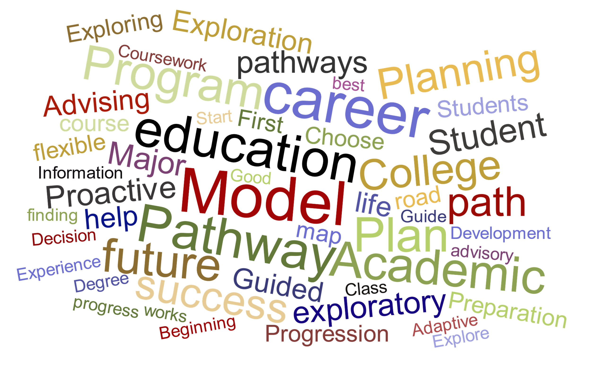
Key Question: What should we call this program?
Education Model Naming: Unaided (Left); Aided (Right)
Prospective Traditional Students: n = 203
Potential options surfaced during in the quantitative research include: “Guided Pathways”, “Personalized Pathways”, or “College-to-Career Pathway”
The terms “Model”, “Pathway”, “Career”, “Academic”, and “Program” are most frequently used to describe the Pathways model. “Career Pathway”, “Guidance”, “Individualized” and “Pathways” resonate best with prospective students among the terms tested.
Q25 (Open-Ended): Based on the definition above, what term would you use if you were in charge of naming this education model?
Q26: Based on the description of the model, how likely would you be to include the following terms in either the name or description of the model?
Top Two Box

Slide 18
Strategic Recommendations
1
6
Ease concerns around selecting an area of study during the application process
Parents and students are concerned when they hear that students will be required to select an area of study during the application process – clarifying the outcomes and impact of this decision will be key to easing concerns.
Create a FAQ page for stakeholders to reference
Both influencers and students have questions they want answered regarding the Pathways model. Having answers to these questions in a centralized location will be important in creating consistency and support for individuals seeking additional information.
2
7
Emphasize the class scheduling support that is available to students
The first thing prospective students want to choose upon college acceptance is their course schedule. This is also an area of concern for many students who are unfamiliar with college. This service will help show how the Pathways model is student focused.
Build area of study descriptions and course maps
Area of study descriptions and course maps are some of the most requested tools by all students. They also support some of the primary concerns and challenges faced by prospective students as they register for college.
3
8
If changing the name of the model, use the words “guided”, “individualized”, or “career” in the title
Of the terms tested, these resonated most with both the influencer and student populations. These terms show a sense of support for the students and an outcome-focused model that is attractive to each student segment.
Emphasize the simplicity, clarity, and flexibility of the Pathways model as it pertains to students
Students find the most significant benefits of the Pathways model to be the simplicity and clarity it brings to the student decision-making process. Emphasize these benefits while also addressing students’ concerns on rigidity.
4
9
Create or revamp a visual depiction of the Pathways model at SLCC
Both influencers and students like the idea of a visual depiction of the Pathways model to better understand its format. This visual map is the first thing students will look for when the formal announcement and implementation has been made.
Use terminology that is familiar and resonates with key stakeholders
Terms like “undecided”, “degree”, and “getting my generals” are preferred by all student segments. Use these terms, as well as other preferred terminology, in the targeted marketing ads.
5
10
Clarify the effects of student decisions
Students, parents, and counselors are concerned with what happens when a student decides to switch areas of study. Messaging during the rollout needs to address these concerns and clarify differences from the current model.
Provide accessible, comprehensive information online
Students, parents, and counselors want to be able to quickly dive deep into particular areas of study. Making information regarding decision making and the areas of study readily available online will be essential.

Slide 19
Agenda
4 | Background, Objectives, and Methodology
7 | Executive Summary and Strategic Recommendations
21 | QUANTITATIVE INSIGHTS – STUDENT SURVEY
 | Academic Terminology Used
 | Student Decision-Making Process
 | College Attribute Importance
 | Introduction to Pathways
 | Pathways at SLCC
60 | QUALITATIVE INSIGHTS
 | Parent Focus Groups
 | High School Counselor Interviews
86 | Appendix

Slide 20
Agenda
4 | Background, Objectives, and Methodology
7 | Executive Summary and Strategic Recommendations
21 | QUANTITATIVE INSIGHTS – STUDENT SURVEY
 | Academic Terminology Used
 | Student Decision-Making Process
 | College Attribute Importance
 | Introduction to Pathways
 | Pathways at SLCC
60 | QUALITATIVE INSIGHTS
 | Parent Focus Groups
 | High School Counselor Interviews
86 | Appendix

Slide 21
Most feel that “undecided” represents having not chosen a degree or certification. “Getting my general” means taking the required and broad classes.
Undecided Degree or Certification
Prospective Traditional: n = 203; Current Traditional: n = 318; Current Non-traditional: n = 337
Prospective Traditional
Current Traditional
Current Non-Traditional
Assume you are a College student that has not decided which degree or certification to pursue.
I am…
“Getting my generals” means you are…
Q9 : Assume you are a student in college who has not decided which degree or certification to pursue in your studies. What term would you use to complete the following sentence: “I am ___________.”
Q14: The phrase, “Getting my generals” means you are…

Slide 22
Prospective and traditional students interchange the words degree and certification more than non-traditional students do.
Understanding of the Term “Degree”
Prospective Traditional: n = 203; Current Traditional: n = 318; Current Non-traditional: n = 337
Prospective Traditional
Current Traditional
Current Non-Traditional
What does the term “degree” mean to you?
Which of the following best describes the term “degree”?
Q12 (Open-Ended): In an educational context, what does the term “degree” mean to you?
Q13: Which of the following best describes the term “degree”?

Slide 23
All student populations agree that degrees are not equivalent to certificates. It is also very important for all populations to receive a degree and slightly more so for non-traditional.
Perception of Degrees vs. Certificates
Prospective Traditional: n = 203; Current Traditional: n = 318; Current Non-traditional: n = 337
Prospective Traditional
Current Traditional
Current Non-Traditional
Describe the difference
Do you believe there is a difference between a certificate and a degree?
Degrees vs. Certificate
“A certificate certifies you to work in that field, a degree shows that you are knowledgeable in that field.”
How important is it that you earn a degree rather than a certificate?
“A certificate is a document that says that you know a subject, while a degree indicates that you know an area of study.”
Importance of A Degree
“A certificate indicates mastery in a very specific application while a degree includes a broad base of knowledge acquired in pursuit of an area of specialization..”
Q42: Do you believe there is a difference between a certificate and a degree?
Q43 (Open-Ended): Please briefly describe the difference between a certificate and a degree.
Q44: How important is it that you earn a degree rather than a certificate? (Top Two Box)

Slide 24
Agenda
4 | Background, Objectives, and Methodology
7 | Executive Summary and Strategic Recommendations
21 | QUANTITATIVE INSIGHTS – STUDENT SURVEY
 | Academic Terminology Used
 | Student Decision-Making Process
 | College Attribute Importance
 | Introduction to Pathways
 | Pathways at SLCC
60 | QUALITATIVE INSIGHTS
 | Parent Focus Groups
 | High School Counselor Interviews
86 | Appendix

Slide 25
Key Steps in a Student’s College Decision-Making Process
Pre-College academic plans
First step when attending college
Motivations for course selection
Declaring an area of study, major, or career
STUDENT JOURNEY

Slide 26
Key Steps in a Student’s College Decision-Making Process
Pre-College academic plans
First step when attending college
Motivations for course selection
Declaring an area of study, major, or career
STUDENT JOURNEY

Slide 27
Prior to attending college, non-traditional students have a more clear idea of what they would like to study prior to attending college than traditional and prospective students do.
Academic Plans Prior to College
Prospective Traditional: n = 203; Current Traditional: n = 318; Current Non-traditional: n = 337
Prospective Traditional
Current Traditional
Current Non-Traditional
About 1/3 of students do not have a clear idea of what they’d like to study
INSIGHT:
There are a significant number of students (35%) that have no idea or only a vague idea of what to study. This represents an opportunity for colleges or universities to better educate or prepare students before attending college.
Q16: Which of the following best describes your academic plans prior to starting college?

Slide 28
Key Steps in a Student’s College Decision-Making Process
Pre-College academic plans
First step when attending college
Motivations for course selection
Declaring an area of study, major, or career
STUDENT JOURNEY

Slide 29
Most students’ first step is finding a major, a career path and the needed classes regardless of student segment.
First Step When Attending College
Prospective Traditional: n = 203; Current Traditional: n = 318; Current Non-traditional: n = 337
Prospective Traditional
Current Traditional
Current Non-Traditional
Once students are enrolled, they seem to be more aware that deciding a major is the first step that they need to take
INSIGHTS:
Traditional students are significantly more concerned about selecting a major than other groups of students. This could provide an opportunity for counseling centers to better meet the needs of traditional students as well as other students as they try to decide majors as a first step.
Prospective students are more concerned about classes than any other collegiate decision – helping them through this process will be essential to student satisfaction.
Q15: Thinking about your own experience and preferences, which of the following terms would you use to best complete the following sentence: When I start college, my first step will be to choose _____.

Slide 30
Key Steps in a Student’s College Decision-Making Process
Pre-College academic plans
First step when attending college
Motivations for course selection
Declaring an area of study, major, or career
STUDENT JOURNEY

Slide 31
Non-traditional students are more concerned with working a specific career while prospective and traditional students want an interesting and satisfying field of study.
Motivations Around Course Selection
Prospective Traditional: n = 203; Current Traditional: n = 318; Current Non-traditional: n = 337
Prospective Traditional
Current Traditional
Current Non-Traditional
Primary Motivations for Selecting Courses and Trajectory
Studying a field that is academically satisfying / interesting
Working in a specific career
Desired Introduction from College Courses
Getting a specific degree
Figuring out what I want to do after graduation
Finishing school as fast as possible
Transferring more of my college credits to another school
Making the most money possible
Q18: Which of the following motivations is primarily driving your decisions around courses and overall trajectory?
Q19 (Open-Ended): Please complete the following sentence: I want my college classes to give me an introduction to several _________.

Slide 32
The most difficult tasks in choosing a class schedule are finding classes that fit student schedules and have availability.
Difficult Steps in Choosing a Class Schedule
Current Traditional: n = 318; Current Non-traditional: n = 337
Current Traditional
Current Non-Traditional
Q41: How difficult are the following steps when choosing your class schedule?
Top Two Box

Slide 33
Key Steps in a Student’s College Decision-Making Process
Pre-College academic plans
First step when attending college
Motivations for course selection
Declaring an area of study, major, or career
STUDENT JOURNEY

Slide 34
Almost all students prefer to declare a major after acceptance AND after meeting with an academic advisor.
Declaring a Major or Focus
Prospective Traditional: n = 203; Current Traditional: n = 318; Current Non-traditional: n = 337
Prospective Traditional
Current Traditional
Current Non-Traditional
Q17: Assume you have just been accepted to a college or university. Which of the following best describes when you would want to declare your major or area of focus?

Slide 35
Across all student segments, passion for the topic is the most important factor for selecting a career or major and area of interest and salary projections follow.
Factors When Choosing a Career or Major
All Respondents, n=858
Weighted Response Rates
Ranking Top 3
First Factor
Second Factor
Third Factor
Prospective and traditional students have relatively similar factors when considering a major, while non-traditional students place slightly more emphasis on salary projections.
Q20: Considering only the list below, what are the top three factors that matter to you when you are choosing a career and major?

Slide 36
It is difficult to find a major that aligns with interests and passions as well as something that makes substantial income.
Difficulties of Choosing Major, Degree or Certification
All Respondents, n=858
Weighted Response Rates
Ranking Top 3
Most Difficult
Second Most Difficult
Third Most Difficult
Not knowing what I am passionate about
Finding something I’m interested in
Finding a job or industry I want to work in
Finding a job that will make a substantial income
Finding majors that lead to the job I want
Knowing how long it will take to earn a degree or certificate
Knowing what options are available
Not having a plan for my future
Finding something I am good at
Finding a major that will lead to a good job
Knowing the majors that have the highest job placement
Managing the opinions of family members
Finding a major that will transfer
Q21: Considering only the list below, what are the top three most difficult parts of choosing a major, degree, or certification?

Slide 37
Students want personal advice from professional counselors, then they look to career opportunities and starting salary projections
Information for Making Decisions on Career or Major
All Respondents, n=858
Weighted Response Rates
Ranking Top 3
Most Helpful
Second Most Helpful
Third Most Helpful
Professional advice and counseling
Requirements for being accepted into a career or major
Free personality tests to determine ideal school and career progression
Descriptions of the growth opportunities available in each career
Starting salary projections
Time it will take to earn a degree or certificate
Providing lists of available options
Reports on the projected future of the field
How my course work will transfer to another university
Job placement percentages
Summary descriptions of the up-and-coming careers
Q22: Considering only the list below, what are the top three kinds of information or tools that would help you make a decision on a career or major?

Slide 38
College and high school academic advisors are seen as important across all student segments.
Importance of Academic Advisors
Prospective Traditional: n = 203; Current Traditional: n = 318; Current Non-traditional: n = 337
Prospective Traditional
Current Traditional
Current Non-Traditional
High School Academic Advisors
Not at all important
Unimportant
Slightly unimportant
Neutral
Slightly Important
Important
Extremely Important
College Academic Advisors
Not at all important
Unimportant
Slightly unimportant
Neutral
Slightly Important
Important
Extremely Important
Q23: How important are high school academic advisors in helping you choose a college major, degree, or certification?
Q24: How important are college academic advisors in helping you choose a college major, degree, or certification?

Slide 39
Agenda
4 | Background, Objectives, and Methodology
7 | Executive Summary and Strategic Recommendations
21 | QUANTITATIVE INSIGHTS – STUDENT SURVEY
 | Academic Terminology Used
 | Student Decision-Making Process
 | College Attribute Importance
 | Introduction to Pathways
 | Pathways at SLCC
60 | QUALITATIVE INSIGHTS
 | Parent Focus Groups
 | High School Counselor Interviews
86 | Appendix

Slide 40
To understand which messages students value the most, MaxDiff was leveraged to force trade-offs and derive a utility score of student preferences
Maximum Differential Methodology
Methodology
Maximum Differential (“MaxDiff”) methodology allows students to compare a long list of items in small groups, which increases accuracy, and forces multiple tradeoffs comparing the same items, which increases precision.
Example of Survey Question
Most Likely | On the next several pages, you will be presented with 5 statements about College A, a hypothetical college in your area. Select the statement most likely to prompt you to learn more about College A and the statement least likely to prompt you to learn more about College A. | Least Likely
 | You will have your program details, such as course requirements and schedules, clearly mapped out at College A
 | You are more likely to get the job you want after completing your program because College A prioritized job attainment
 | You will have access to academic advisors with specialized knowledge of your chosen field of study at College A
 | You will stay on track and complete your studies as quickly as possible by following highly structured programs at College A
Example of Results
MaxDiff yields a Share of Preference utility score that shows which items a respondent prefers, or in our example which items are most important to prospective students
Outcomes | Student Support | Academic Planning | Other

Slide 41
Overall, students prefer messaging that relates to educational outcomes. Clear course requirements and maps have the most positive affect on students.
Comparative College Offerings
n = 858
1 | You will have your program details, such as course requirements and schedules, clearly mapped out at College A
2 | You are more likely to get the job you want after completing your program because College A prioritized job attainment
3 | You begin learning skills that are applicable to your area of study earlier in your education at College A
4 | You will be able to successfully transfer to a 4-year university upon completion of your studies at College A
5 | You will have access to academic advisors with specialized knowledge of your chosen field of study at College A
6 | You will stay on track and complete your studies as quickly as possible by following highly structured programs at College A
7 | You will be more likely to complete your Associate degree in 2 years at College A than students at other colleges
8 | You will create a plan for your future education and career with the academic advisors at College A
9 | You will discover your educational and career goals by working with academic advisors at College A
10 | You do not need to decide on a major right away and will not fall significantly behind in your first year at College A
11 | You will clarify your future path to further education or a career by working with academic advisors at College A
12 | You will complete prerequisites for similar degrees and not fall behind by switching between similar degrees at College A
13 | You will have academic advisors proactively set up appointments to meet with you once a semester at College A
14 | You do not have to decide on your own what courses to take during your first year of school at College A
15 | You will be required to create an academic plan based on your program map while at College A
16 | You must choose a broad area of study at College A prior to starting your college classes
Outcomes as a whole matter most
Student Support
Academic Planning
Outcomes
Q35: Select the statement most likely to prompt you to learn more about College A and the statement least likely to prompt you to learn more about College A.

Slide 42
Prospective students find the student support messaging more attractive than the overall student population does, but are still focused on planning and outcomes.
Comparative College Offerings
Prospective Traditional Students: n = 203
1 | You will have your program details, such as course requirements and schedules, clearly mapped out at College A
2 | You begin learning skills that are applicable to your area of study earlier in your education at College A
3 | You are more likely to get the job you want after completing your program because College A prioritized job attainment
4 | You will have access to academic advisors with specialized knowledge of your chosen field of study at College A
5 | You will stay on track and complete your studies as quickly as possible by following highly structured programs at College A
6 | You do not need to decide on a major right away and will not fall significantly behind in your first year at College A
7 | You will discover your educational and career goals by working with academic advisors at College A
8 | You will create a plan for your future education and career with the academic advisors at College A
9 | You will be able to successfully transfer to a 4-year university upon completion of your studies at College A
10 | You will clarify your future path to further education or a career by working with academic advisors at College A
11 | You will be more likely to complete your Associate degree in 2 years at College A than students at other colleges
12 | You do not have to decide on your own what courses to take during your first year of school at College A
13 | You will have academic advisors proactively set up appointments to meet with you once a semester at College A
14 | You will complete prerequisites for similar degrees and not fall behind by switching between similar degrees at College A
15 | You will be required to create an academic plan based on your program map while at College A
16 | You must choose a broad area of study at College A prior to starting your college classes
Student Support
Academic Planning
Outcomes
Q35: Select the statement most likely to prompt you to learn more about College A and the statement least likely to prompt you to learn more about College A.
*Note: highlighted cells show a difference in order preference for the attribute indicated

Slide 43
Outcomes and academic planning are more important to traditional students than to the overall student population.
Comparative College Offerings
Current Traditional Students: n = 318
1 | You will have your program details, such as course requirements and schedules, clearly mapped out at College A
2 | You are more likely to get the job you want after completing your program because College A prioritized job attainment
3 | You will be able to successfully transfer to a 4-year university upon completion of your studies at College A
4 | You begin learning skills that are applicable to your area of study earlier in your education at College A
5 | You will have access to academic advisors with specialized knowledge of your chosen field of study at College A
6 | You will be more likely to complete your Associate degree in 2 years at College A than students at other colleges
7 | You will stay on track and complete your studies as quickly as possible by following highly structured programs at College A
8 | You do not need to decide on a major right away and will not fall significantly behind in your first year at College A
9 | You will discover your educational and career goals by working with academic advisors at College A
10 | You will complete prerequisites for similar degrees and not fall behind by switching between similar degrees at College A
11 | You will create a plan for your future education and career with the academic advisors at College A
12 | You will clarify your future path to further education or a career by working with academic advisors at College A
13 | You will have academic advisors proactively set up appointments to meet with you once a semester at College A
14 | You do not have to decide on your own what courses to take during your first year of school at College A
15 | You will be required to create an academic plan based on your program map while at College A
16 | You must choose a broad area of study at College A prior to starting your college classes
Student Support
Academic Planning
Outcomes
Q35: Select the statement most likely to prompt you to learn more about College A and the statement least likely to prompt you to learn more about College A.
*Note: highlighted cells show a difference in order preference for the attribute indicated

Slide 44
Non-traditional students largely follow the overall student population preferences regarding college offerings.
Comparative College Offerings
Current Non-traditional Students: n = 337
1 | You will have your program details, such as course requirements and schedules, clearly mapped out at College A
2 | You are more likely to get the job you want after completing your program because College A prioritized job attainment
3 | You begin learning skills that are applicable to your area of study earlier in your education at College A
4 | You will be able to successfully transfer to a 4-year university upon completion of your studies at College A
5 | You will have access to academic advisors with specialized knowledge of your chosen field of study at College A
6 | You will stay on track and complete your studies as quickly as possible by following highly structured programs at College A
7 | You will be more likely to complete your Associate degree in 2 years at College A than students at other colleges
8 | You will create a plan for your future education and career with the academic advisors at College A
9 | You will complete prerequisites for similar degrees and not fall behind by switching between similar degrees at College A
10 | You will clarify your future path to further education or a career by working with academic advisors at College A
11 | You will discover your educational and career goals by working with academic advisors at College A
12 | You do not need to decide on a major right away and will not fall significantly behind in your first year at College A
13 | You will have academic advisors proactively set up appointments to meet with you once a semester at College A
14 | You do not have to decide on your own what courses to take during your first year of school at College A
15 | You will be required to create an academic plan based on your program map while at College A
16 | You must choose a broad area of study at College A prior to starting your college classes
Student Support
Academic Planning
Outcomes
Q35: Select the statement most likely to prompt you to learn more about College A and the statement least likely to prompt you to learn more about College A.
*Note: highlighted cells show a difference in order preference for the attribute indicated

Slide 45
Agenda
4 | Background, Objectives, and Methodology
7 | Executive Summary and Strategic Recommendations
21 | QUANTITATIVE INSIGHTS – STUDENT SURVEY
 | Academic Terminology Used
 | Student Decision-Making Process
 | College Attribute Importance
 | Introduction to Pathways
 | Pathways at SLCC
60 | QUALITATIVE INSIGHTS
 | Parent Focus Groups
 | High School Counselor Interviews
86 | Appendix

Slide 46
Prospective students use words that have a helpful or academic connotation to describe the Pathways model.
Education Model Naming: Unaided (Left); Aided (Right)
Prospective Traditional Students: n = 203
The terms “Model”, “Pathway”, “Career”, “Academic”, and “Program” are most frequently used to describe the Pathways model. “Career Pathway”, “Guidance”, “Individualized” and “Pathways” resonate best with prospective students among the terms tested.
Q25 (Open-Ended): Based on the definition above, what term would you use if you were in charge of naming this education model?
Q26: Based on the description of the model, how likely would you be to include the following terms in either the name or description of the model?

Slide 47
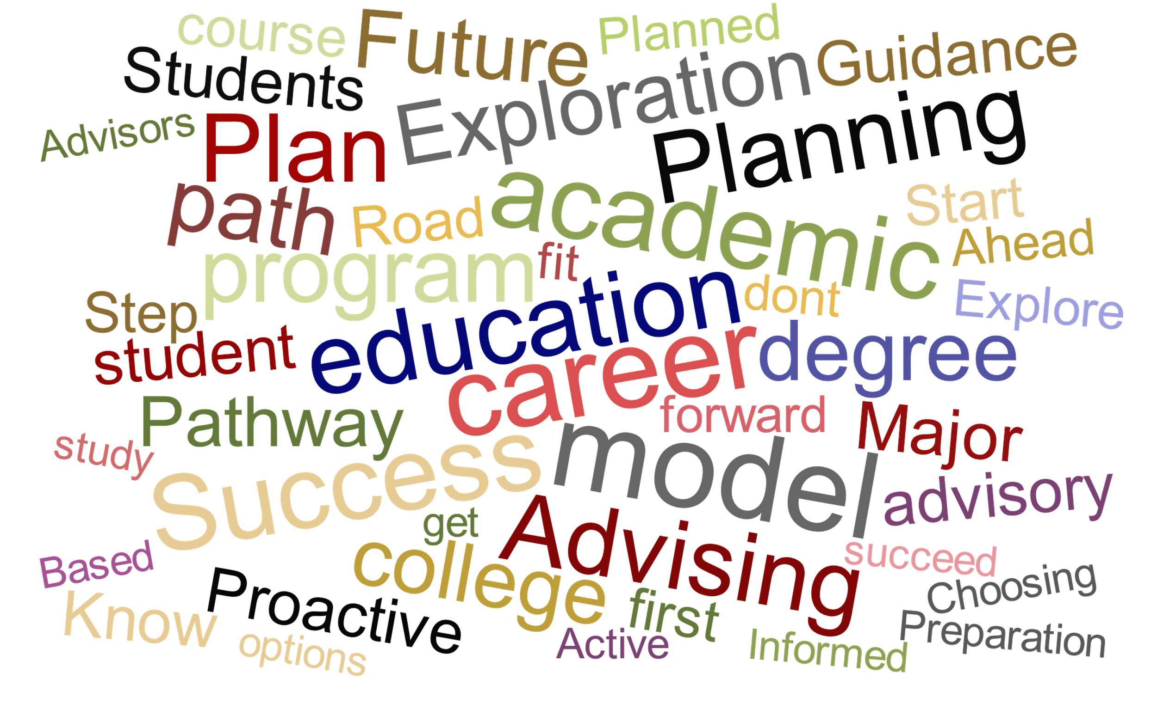
Traditional students describe the model with words that show pathways, opportunities, and individualized supports.
Education Model Naming: Unaided (Left); Aided (Right)
Current Traditional Students: n = 318
“Opportunity” and “Supportive” are terms that are more attractive to traditional students than to other groups.
Q25 (Open-Ended): Based on the definition above, what term would you use if you were in charge of naming this education model?
Q26: Based on the description of the model, how likely would you be to include the following terms in either the name or description of the model?

Slide 48
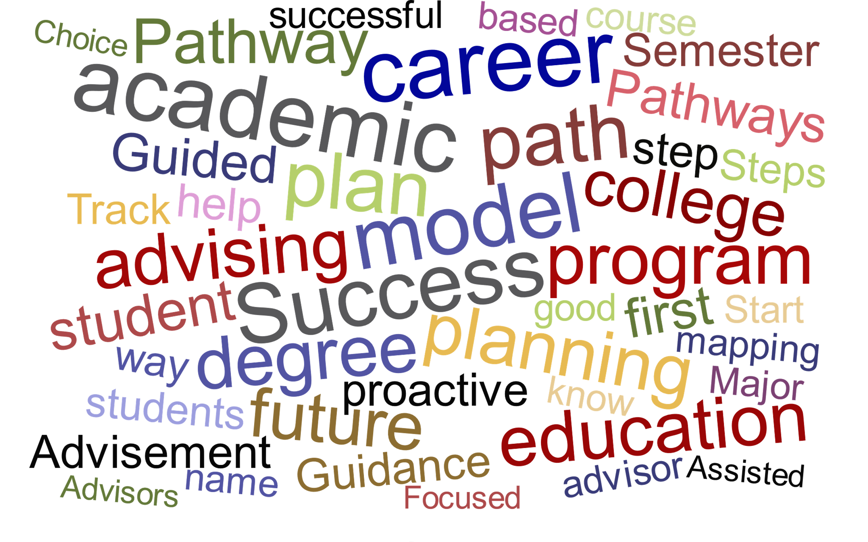
Non-traditional students emphasize the focused and planning aspects of the academic model when they describe Pathways.
Education Model Naming: Unaided (Left); Aided (Right)
Current Non-traditional Students: n = 337
“Success”, “Academic”, “Planning”, “Advising”, and “Career” are the most commonly used terms used to describe the education model. Non-traditional students tend to use words that allude to a more direct, focused program than existing models. These individuals like the direction that the Pathways model offers.
Q25 (Open-Ended): Based on the definition above, what term would you use if you were in charge of naming this education model?
Q26: Based on the description of the model, how likely would you be to include the following terms in either the name or description of the model?

Slide 49
The vast majority of the student population has a positive perception of the Pathways model.
Reaction to Pathways
Prospective Traditional: n = 203; Current Traditional: n = 318; Current Non-traditional: n = 337
Prospective Traditional
Current Traditional
Current Non-Traditional
79% of total population
Only 6% of the current and prospective student population has a negative perception of the Pathways model. Implementing the Pathways model at Salt Lake Community College should not detract from the current brand and reputation of the college.
Q27: What is your overall reaction to this Pathways model?

Slide 50
Students need a visual map of the Pathways model to show fit with the school. Degree requirements and program costs are secondary items students will research.
Steps to Determine Fit
Prospective Traditional: n = 203; Current Traditional: n = 318; Current Non-traditional: n = 337
Prospective Traditional
Current Traditional
Current Non-Traditional
Q31: What is the first thing you would want to see to determine if it is the right fit for you?
Q32: After researching [insert previous answer], which of the following topics, if any, would you research next?

Slide 51
Understanding what happens if they don’t know what they want to study, and then what happens if they switch their area of study are the top questions students want answered.
Questions to Answer about Pathways
All Respondents, n=858
Weighted Response Rates
Ranking Top 3
First Question
Second Question
Third Question
What if I don’t know what I want to study?
How will I make the academic plan?
How long will it take me to graduate?
What happens if I want to switch my area of study?
Can I change my area of study after I have started?
Will my credits still transfer to other colleges and universities?
How frequently will I need to meet with the academic advisor?
Will my teachers have specific knowledge of my chosen area of study?
Do I have to take my suggested classes my first year?
Why would a college make this change?
Q33: Considering only the list below, what are the top three questions you would like answered based on the previous description of the Pathways model?

Slide 52
Students believe they would benefit most from descriptions of each area of study as well as a recommended list of courses to take.
Tools for Understanding Pathways
Prospective Traditional: n = 203; Current Traditional: n = 318; Current Non-traditional: n = 337
Prospective Traditional
Current Traditional
Current Non-Traditional
INSIGHTS:
Students want to have the information readily available to explore their options, but they also want to have a default course map to use if they should choose to use it.
Do not waste internal resources on creating video training examples of the Pathways model – this is not something students are looking for in this transition period.
Q34: How helpful would each of the following tools be to help you better understand the purpose and organization of the Pathways model?
Top Two Box

Slide 53
Agenda
4 | Background, Objectives, and Methodology
7 | Executive Summary and Strategic Recommendations
21 | QUANTITATIVE INSIGHTS – STUDENT SURVEY
 | Academic Terminology Used
 | Student Decision-Making Process
 | College Attribute Importance
 | Introduction to Pathways
 | Pathways at SLCC
60 | QUALITATIVE INSIGHTS
 | Parent Focus Groups
 | High School Counselor Interviews
86 | Appendix

Slide 54
Students from each segment believe that the Pathways model will be a beneficial addition to the SLCC campus and will help clarify a student’s future.
Benefits of Pathways
Prospective Traditional: n = 203; Current Traditional: n = 318; Current Non-traditional: n = 337
Prospective Traditional
Current Traditional
Current Non-Traditional
Theme | Feedback Received
Ease of decision making (~25% of population) | “There will be less people who are confused on what they want to study. They will have a more clear path and will save a lot more money and have less debt” “Help confused students feel less overwhelmed and find a good path for them” “This will benefit students that have not picked a degree and are unfamiliar with the college setting”
Clearer paths / plans (~25% of population) | “People will be on a path that is both effective and efficient. I personally wasted a lot of my time and money because of not knowing what classes transfer to other universities and what classes would go towards what I wanted to major in.” “Giving new students the ability to plan ahead” “To help students know what requirements they specifically need to transfer to a university”
Increased student success / graduation (~20% of population) | “Higher graduation rate along with students being more prepared to continue their education after” “I think it will help undeclared students as well as motivate students to finish their degree” “Students will have an increased likelihood of getting a degree and/or learning skills that are directly applicable to their careers and lives.”
Saves time / money (~20% of population) | “Help students find their career path faster, without getting burned out wandering through college” “I think it will help more people complete their degrees faster than anticipated” “A higher graduation rate, retention rate, and faster completion of course work per student”
Greater guidance (~20% of population) | “It will help new students gain a sense of direction in their studies” “I think students will be able to have a better outline of how to accomplish their future and career goals with the help of advisors as well as figure out what their goals are if not already decided on.” “A plan for each student and helping them plan that out will be really beneficial.”
Transferability (~5% of population) | “It will help students prepare better and be more confident and ready to get their associates and transfer” “It will give students a more direct path to graduate or to continue on to a 4 year school” “I think people will finish quicker and move to a four year college once they have completed their courses at SLCC”
Q37 (Open-Ended): What do you think will be the benefits of implementing a Pathways model at Salt Lake Community College?
NOTE: Categories are not mutually exclusive

Slide 55
There are, however, some concerns among the student populations that must be addressed to promote SLCC and the Pathways model in the best manner.
Concerns with Pathways
Prospective Traditional: n = 203; Current Traditional: n = 318; Current Non-traditional: n = 337
Prospective Traditional
Current Traditional
Current Non-Traditional
Theme | Feedback Received
Rigidity (~10% of population) | “The fact that it seems extremely regimented because of some of the phrases you used. You should try to rephrase it so its more positive and optimistic rather than strict” “This might limit students in discovering what goals they have and will provide less diversity in what classes a student can take” “People may feel overwhelmed or trapped in their decision”
Not enough awareness / Low enrollment (~10% of population) | “People not knowing about it and advisers not being fully aware of what they are doing” “For the program to not be exposed enough therefore it might “disappear”” “The information not being communicated or available to non-traditional students”
Choosing a career path so early (~8% of population) | “The fact that it would scare people away because they literally have no idea of what they want to do” “If people who are undecided when they first apply, will they be pressured to make a choice when they apply” “Pressure to choose a major too quickly and not being happy with it”
Confusing / Stressful for students (~5% of population) | “Students might not know what they want to study and could have anxiety if forced to choose a major before starting.” “Further confusing people who don't know what they want from college” “That the program adds to the complexities of college instead of making it easier”
Credibility / Effectiveness (~5% of population) | “Students won’t follow through with each step of the program” “Mostly that It won’t be super effective early on due to It being a new program and students being unaware of its existence” “SLCC can sometimes be a very disorganized place and I worry it would not be carried out effectively for a while”
Over one-third of all the students said they were not worried about any portion of the Pathways model being implemented at SLCC. SLCC is well positioned for implementing this model into its current structure.
Q38 (Open-Ended): What concerns do you have about this program being implemented specifically at Salt Lake Community College?
NOTE: Categories are not mutually exclusive

Slide 56
The vast majority of current students believe the Pathways model would have improved or not influenced their opinions of SLCC.
Effect of Pathways on Student Decision Making
Current Traditional: n = 318; Current Non-traditional: n = 337
Current Traditional
Current Non-Traditional
More Guidance / Clarity | “Because I was nervous and unsure how to start college” “Anything that would assist me in knowing exactly what classes or actions I need to make to help finish my education would be more ideal in choosing a school”
SLCC Cares | “Because I would know that they cared about my future and helping me get there. It’s more personal” “Because it is basically telling me that SLCC actually cares about me and my future, and they want to see me and their students complete their career or degree”
Easier / Less Stressful | “Because it’d calm down my anxiety of what I’m going to do and where I’m going to go in the future” “I would have had a much easier time figuring out what classes I needed”
Extra Requirements | “I would worry about it being another useless requirement I have to fulfill before really starting my degree” “Because I don’t need another requirement that has to be completed so I can graduate”
Effect on Brand | “In my opinion, it cheapens the overall look of the school” “I’m smart enough to have navigated the existing model, so I don’t feel the changes are beneficial”
Control of Students | “It gives the school too much control over students’ choices” “I don’t mind the hands-off approach. I will ask for help if I need it”
Q39: If Salt Lake Community College had implemented a model like Pathways prior to your application and attendance at the school, which of the following statements best describes you?
Q40 (Open-Ended): Why did you select [insert previous answer]?

Slide 57
When learning about the changes associated with the Pathways model, all students prefer the SLCC website for their notifications with ancillary touch points also addressed.
Information Distribution
Prospective Traditional: n = 203; Current Traditional: n = 318; Current Non-traditional: n = 337
Prospective Traditional
Current Traditional
Current Non-Traditional
INSIGHTS:
Each student segment wants to learn of the changes with the Pathways model through the primary touchpoints the student has with the college – current students want to learn through the website and their SLCC school accounts while prospective students want to learn of the changes through their high school counselors and orientation meetings.
Other than these primary touchpoints, students are not expecting the updates to come through specific communication medium
Q36: Where do you want to hear about the changes that are going to be made? Select up to three options.

Slide 58
Agenda
4 | Background, Objectives, and Methodology
7 | Executive Summary and Strategic Recommendations
21 | QUANTITATIVE INSIGHTS – STUDENT SURVEY
 | Academic Terminology Used
 | Student Decision-Making Process
 | College Attribute Importance
 | Introduction to Pathways
 | Pathways at SLCC
60 | QUALITATIVE INSIGHTS
 | Parent Focus Groups
 | High School Counselor Interviews
86 | Appendix

Slide 59
Agenda
4 | Background, Objectives, and Methodology
7 | Executive Summary and Strategic Recommendations
21 | QUANTITATIVE INSIGHTS – STUDENT SURVEY
 | Academic Terminology Used
 | Student Decision-Making Process
 | College Attribute Importance
 | Introduction to Pathways
 | Pathways at SLCC
60 | QUALITATIVE INSIGHTS
 | Parent Focus Groups
 | High School Counselor Interviews
86 | Appendix

Slide 60
While many terms were met with indifference, many parents feel strongly about the following terminology when learning about the Pathways model.
Overview of Key Terms and Phrases
Parent Focus Group Worksheets and Discussion
USE
“Discover their goals” “Professions” “Students do not have to select a specific major or degree before enrolling” “Proactive outreach from advisors” Generally positive statements about providing students with more resources and guidance
AVOID
Focusing on “degrees” over “professions” “Clarify a student’s future path” “Exposure” “Disciplines” Messages that convey avoiding a negative consequence if a student switches majors
REWORK
“Select area of study during the application process” Explanation of transferability of Pathways Explanation of concern with switching areas of study The overall Pathways image The misnomer that Pathways is a vocational program
Parents want to know their children will be empowered by SLCC with resources and guidance, but do not want their student to feel trapped in an area of study because they have to choose one in the application process
*Seen as either very positive or very negative word in parents’ minds

Slide 61
Pathway, fast track, guided, and focused are common words used to describe the Pathways model. Overall, parents do not feel the model is very flexible.
Words Used to Describe the Model
Parents: n = 30
Word | Feedback Received
Career Pathway | “If they know their goal is a particular career, this is the path they need to stay on”
Degree Pathway | “It’s a way to get to a certain degree”
Module / Branch | “One would be like a STEM branch, another liberal arts, and things like that”
Directed Pathway to Success | “I think as long as it came across that it was a directed pathway it would be good”
Global Learning | “It sounds like the IB program at Midvale and Hillcrest”
Fast track | “They’re not messing around, they’re being funneled or channeled”
Guidance | “It’s my idea that you are guiding me where I want to go”
Vocational | “It is giving them a direction to a career”
Focused | “It’s helping people get focused on their career and what they want to do”
Profession Training | “You said some partnerships with businesses, so you see an end and you know what your ending is going to be”
Skilled | “When you fast track through your generals, you get to upper level and start learning skills of your trade”
Funneled | “You’re taking away options, so you’re kind of funneled or corralled into a degree”
Other Common Words Used to Describe Pathways
Targeted Supportive Directed Opportunity Discovery Rigid Specialized Customized Individualized Pigeon-holed
Most commonly preferred names:
Career Pathway
Fast track
Most commonly used words to describe the model:
Focused
Funneled
Fast
Vocational
Directed
These terms should be tested further in the student survey.
Q: If you had to choose one word or phrase to name the model we just described, which word(s) would you choose?

Slide 62
Parents like messages that indicate their students have an opportunity to explore their interests and dislike ideas that feel rigid or forceful.
Pathways Model Evaluation
Parents: n = 30; Worksheet #1
Most Disliked Idea
Most Liked Idea
Help students create a plan
Clarify a student’s future path
Help students discover their goals
Students select one of a few broad study paths during the application process
Students do not have to select a specific major or degree before enrolling
Students select an area of study during the application process
Classes give exposure to several degrees
Classes give exposure to several professions
Classes give exposure to several disciplines
Academic advisors can expose students to several career paths
Academic advisors have specialized knowledge of a field of study
Academic advisors meet with students who show an interest in the advisor’s area of specialization
3
Set 1
16
7
5
Set 2
1
21
10
Set 3
6
10
8
Set 4
9
8
Q: Please circle the message you like most and cross out the one you like least.

Slide 63
The word “broad” resonates with parents. Parents like messages that indicate the model will “empower” students in the discovery of their own goals and interests.
Positive Statement Evaluation
Parents: n = 30; Worksheet #1
Parents like ideas that deal with students being able to explore different options and discover what they want to study during their college career
Help students discover their goals
Students select one of a few broad study paths during the application process
Students do not have to select a specific major or degree before enrolling
Classes give exposure to several professions
Classes give exposure to several disciplines
Academic advisors can expose students to several career paths
Academic advisors meet with students who show an interest in the advisor’s area of specialization
“It seems more empowering for the student to discover their own goals – it’s their life”
“I liked the word broad, it makes it a lot less scary than a narrow approach”
“I don’t like the idea of a high school student having to declare their intent right up front in school”
“I liked number two because you can know your options right up front”
“I like the broad option in the first year, and the specialized advisor in the second year”
Q: Please circle the message you like most and cross out the one you like least.

Slide 64
Parents dislike messages that convey the sentiment that the college will influence a student into a specific area of study.
Negative Idea Evaluation
Parents: n = 30; Worksheet #1
Parents least like ideas that portray their student being forced to do something they do not enjoy or that define a student’s path
Clarify a student’s future path
Students select an area of study during the application process
Classes give exposure* to several degrees
Classes give exposure* to several disciplines
Academic advisors have specialized knowledge of a field of study
Academic advisors can expose students to several career paths
Academic advisors meet with students who show an interest in the advisor’s area of specialization
“I definitely didn’t like ‘clarify a student’s future path’ because they are going to change their mind. When they’re that young, just get in, get started, and hopefully it will come to you”
“Filling out the answer right then is pressuring students, it makes students rush into a choice”
“You can have multiple degrees for a single job type. Most of the time, jobs just want you to have a degree”
“I just don’t even understand what disciplines means. It’s a term that doesn’t make sense to me”
“Expose is just a bad word”
“It is too wordy. I crossed it off because it sounded like they weren’t going to reach out to every child”
Q: Please circle the message you like most and cross out the one you like least.
*The word “exposure” evoked negative connotations in the minds of parents.

Slide 65
Overall, parents like messaging that conveys a sense of guided discovery for their students – giving them the resources needed to find their own interests and goals.
Pathways Model Evaluation
Parents: n = 30; Worksheet #1
Idea 1 | Idea 2 | Idea 3
Help students create a plan “I want my kids involved in making a plan and actually doing something. Goals are part of the plan” | Clarify a student’s future path “I liked that they had a path to work with and then I really liked that you would clarify it for them” “We’re talking about 17, 18, 19 year old kids who don’t have any idea. They don’t know their path” | Help students discover their goals “It seems more empowering for the student to discover their own goals – it’s their own life”
Students select one of a few broad study paths during the application process “I liked the word broad, and didn’t like the negative parts of the other ones” | Students do not have to select a specific major or degree before enrolling “Students go to school to find out what they are interested in” | Students select an area of study during the application process “Filling out the answer right then is pressuring students, it makes students rush into a choice”
Classes give exposure to several degrees “I really don’t like the word exposure.” “Degrees felt like you were pushing students toward a specific major that wasn’t what they wanted” | Classes give exposure to several professions “I like number two because you can know your options right up front” | Classes give exposure to several disciplines “I liked this because it was the most broad. Professions felt pigeon-holed” “I didn’t know what disciplines was talking about”
Academic advisors can expose students to several career paths “I like the broad option in the first year, and the specialized advisor in the second year” | Academic advisors have specialized knowledge of a field of study “…advisor is pushing them down the path that you don’t want to go down. All funneled down the path” | Academic advisors meet with students who show an interest in the advisor’s area of specialization “It is too wordy. I crossed it off because it sounded like they weren’t going to reach out to every child”
Q: Please circle the message you like most and cross out the one you like least. Why do you like that message? What do you not like about that message?

Slide 66
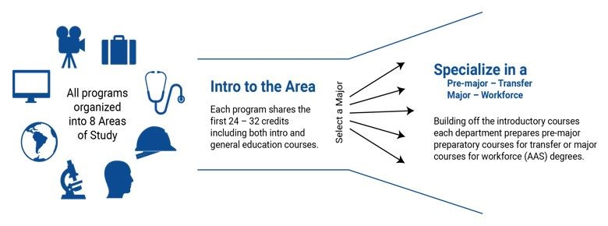
Parents like the visual outline of the Pathways model, but they are confused by the intro section with the initial course options.
Pathways Visual Evaluation
Parents: n = 30
The visual should be used to describe the Pathways model, but it needs to be edited to convey the model in a clear and concise way.
Content of the areas of study and the types of degrees within each
“There may be 10 certificates in the field but you may only offer two. It’s a lot to say you offer these eight areas, but if they are very narrow, it doesn’t mean anything”
Students will take classes related to a single area of study
“The graphic makes it seem like each student takes each course before specializing”
“Oh, you just take classes from one? It needs a lane for each of the eight options then!”
Effects of switching between one area and another
“What if someone changes their major/area of study? Do they have to start over again?”
The term “program” is not clear to the parents
“General education courses” has a different connotation to the public than intended
Timeline for choosing an area of study
How a student specializes when they are taking shared credits
“I think this is super confusing. All share the first 24-32 credits, then how do you specialize? I don’t get that from this at all”
How the areas of study relate to this segment of the visual
“Not really sure how the eight areas of study relate to everything else”
The outcome of the program and options available
“It looks like more of a vocational pathway than a degree pathway”
Students have the ability to take classes outside their chosen area of study if desired
“Right now, you can take both sets of classes, but when I see this, you are given a specific area of focus and can’t take other classes”
Intended to help students transfer rather than as a vocational tool
“Are the classes transferrable? If not, that would make it go against the idea that this leads to the next step”
Points to Clarify
Q: Now that you have seen the visual of the Pathways program, what do you like about the outline? Do you think it is useful? What is confusing about it?

Slide 67
Parents like the straightforward, efficient aspects of the Pathways model. They are most concerned about a lack of flexibility and the ability to choose courses.
Pros and Cons of the Model
Parents: n = 30
Positive Aspects of the Model
Career potential
“This speeds it up so you get to your upper level courses faster, and that is where you start gaining the skills you need to work in your field.”
“If you go on a pathway, you get a reward, and you don’t necessarily have to continue to a higher degree”
Less wasted time
“I like that you can do it quickly. It all builds on each other”
It is easy/simplified
“Well it’s easy for students. Like you said, it’s the default plan for kids to get a college degree”
Helpful academic advisors
“If the people who are giving the advice are in the field and working in the field, that would be more useful to students than anything else to help them learn what to do”
“I think a lot of kids need a lot of mentoring. Someone who can
keep directing them”
Messaging to the parents should do the following:
Promote the simplified process for the students and the proactive, qualified help provided by the academic advisors.
Describe the flexibility of the model and the students’ ability to choose their own courses and switch areas of study.
Display statistics and facts behind transferring credits and degrees to other universities.
Convey a degree/transfer focus for the model.
Concerns with the Model
Being limited with course options
“I’m concerned about the careers that straddle two areas of study. My entire career fits between an electrician and computer scientist”
Switching areas of study
“It seems like if they change their minds, they have lost it all”
Model just for vocational programs
“I would like to see partnerships with businesses, because right now it seems like it would only benefit students for vocational reasons”
Classes/certifications transferring to other universities
“I don’t believe it will transfer to all colleges, that would mean they were all on the same page working together”
Declaring an area of study up front
“Kids don’t know what they want right away”
Key Questions and Concerns
Transferability “How does this program wrap into a bachelor’s degree and where does it transfer” Marketability “I want to see some hard numbers about placement and how much they are going to make after the program” Flexibility “What if they want to switch areas of study?”
Q: What do you like about the Pathways model?
Q: What concerns do you have with the Pathways model?

Slide 68
Choosing a major after starting classes and proactive academic advisors are strongly preferred ideas among parents. Other messaging choices have only slight preferences.
Pathways Idea Evaluation
Parents: n = 30; Worksheet #2
Idea 1 | Idea 2
Advisors provide a default course plan for first-year students | Students do not have to decide on their own what courses to take during their first year
Students are required to meet with an academic advisor once a semester | Academic advisors proactively* set up appointments with students once a semester
Areas of study allow students to easily complete pre-requisites for multiple degrees before deciding on a single degree | Similar degrees share pre-requisites so students do not fall behind if they decide to switch their major or degree
Students do not need to decide exactly what to study right away | Students do not have significant repercussions for switching majors/degrees in their first year of study
Students must choose an area of study prior to starting their college classes | Students can choose a major or degree after starting their college classes
Times Chosen as the Preferred Idea
Idea 1
Idea 2
Q: Please circle the idea from each pair that you like the most. Why did you choose that idea?
*Note: Bolded and underlined terms are words that need to be used in the messaging to promote positive reactions from patents.

Slide 69
Choosing a major after starting classes and proactive academic advisors are strongly preferred ideas among parents. Other messaging choices have only slight preferences.
Pathways Model Idea Evaluation
Parents: n = 30; Worksheet #2
Idea 1 | Idea 2
Advisors provide a default course plan for first-year students** “The only word I don’t like in idea one is ‘default’. When it is put next to ‘provide’ it seems like they are forced to take those classes. You could change it to ‘advisors provide a suggested course…’” “I’d like it more if you put ‘if desired’ in the idea” | Students do not have to decide on their own what courses to take during their first year** “I didn’t like the wording of this one, so I would say something like, ‘My child will be helped to decide on their course plan for the first year’” “I want the advisor sitting down with the student and making the plan”
Students are required to meet with an academic advisor once a semester “Well no one likes to be required to do something” “Kids aren’t going to do it on their own” | Academic advisors proactively set up appointments with students once a semester* “Proactive makes it sound like the advisors are actually engaged in their job. You kind of want that”
Areas of study allow students to easily complete pre-requisites for multiple degrees before deciding on a single degree “I like the phrasing ‘area of study’. I feel like that seems more academic and is more broad” | Similar degrees share pre-requisites so students do not fall behind if they decide to switch their major or degree “You hate the idea that your kid is going to fall behind. I also don’t think it’s true. If she wants to switch from medicine to fine arts, there are going to be some consequences”
Students do not need to decide exactly what to study right away | Students do not have significant repercussions for switching majors/degrees in their first year of study “Not having significant repercussions was comforting” “There should never be significant repercussions in the first year”
Students must choose an area of study prior to starting their college classes “Can vs. must. Must is too strong of a word” “This sounds like the antithesis of the entire program” | Students can choose a major or degree after starting their college classes* “Sometimes, people don’t start college because they are worried that they do not know. This seems more free”
Q: Please circle the idea from each pair that you like the most. Why did you choose that idea?
*Strongly preferred by parents
**Parents indicated that they had to come back to this one because there didn’t appear to be many differences

Slide 70
Parents primarily consider the financial implications of sending their children to a college. Student interests, career outlook, and program rankings influence their choice of degrees.
Factors to Consider when Choosing a School and Major
Parents: n = 30
Choosing a School
Choosing a Major
Affordability
“For my kids, I know cost would have been number one”
Scholarships
“Basically, who’s willing to pay for my child’s schooling”
Programs available
“The school that my daughter attends needs to have her program, not everyone does”
Brand or reputation
“There are certain colleges that are well-known, and companies will look for the school on their resumes”
Atmosphere
“They wanted to make sure their work was ideal for their personality”
Transfer of credits
“The transition is where it is really important, so their work can switch between schools”
Diversity of thought
“I’m looking for ideological diversity”
Program ranking
“Look for the top rated programs in their chosen field”
Individual enjoyment
“You have to look at the fulfillment level that the child feels when they are studying that subject”
“Be happy in what you want to do. If you love what you do and you’re the best at it, you’ll make money”
Earnings after the degree
“You have to weigh what you are going to make after graduating from a degree against what you have to pay in tuition”
Placement of degree
“What is the actual placement after the degree, is it enough for full-time work, or will she need to do something else”
Size of the program
Scholarships available
Accommodates students with special needs
Skills learned in the program
Q: What school attributes or factors matter most to you when helping your child decide upon a school to attend?
Q: What factors or attributes do you consider when helping your child decide which major or area of study to pursue?

Slide 71
Agenda
4 | Background, Objectives, and Methodology
7 | Executive Summary and Strategic Recommendations
21 | QUANTITATIVE INSIGHTS – STUDENT SURVEY
 | Academic Terminology Used
 | Student Decision-Making Process
 | College Attribute Importance
 | Introduction to Pathways
 | Pathways at SLCC
60 | QUALITATIVE INSIGHTS
 | Parent Focus Groups
 | High School Counselor Interviews
86 | Appendix

Slide 72
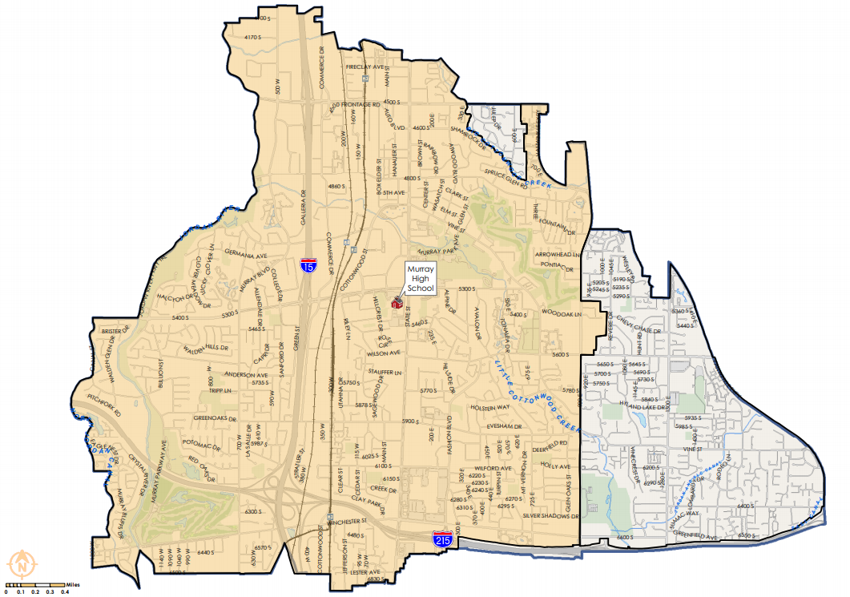
IDI Takeaways – Interview 1
Common Counseling Topics
School: consider GPA, ACT, programs, majors, cost of the school, financial standing of student
Major/Program: help students become aware of the programs and what they like to do
Pathways Understanding and Definition
Way to help kids complete a course of instruction to create a pathway to pursue a job in a particular field
Pathways Visual Evaluation
The images do not explain what the areas of study are. Describe the icons and explain what it actually means to enter an area of study
Idea/Message Evaluation
Take the pressure off the kids and give them flexibility within their career path
Let the students choose their path rather than forcing them or confining them to one set schedule
Tools and Resources
There should be a week-long class students take prior to their first semester that gives them extra orientation to college life
Academic advisors need to help students acclimate to college better from the beginning
High school covered | Murray - Murray School District
Years as a counselor
Heard of Pathways before? | Yes
Length of interview | 38 min
Overall view of Pathways | Positive
Key Takeaways
Students should not feel pressured in their education – they should be given flexibility and help from the college
Counselors are going to want very descriptive information regarding the new model, areas of study, majors within each area of study, and timeline for implementation
Key Quotes
“I think that if we have this, kids would be more motivated to finish rather than floundering from one idea to another without a clear cut path”
“If we are going to organize the areas of study, we need to do a better job at the beginning to help them understand things more”

Slide 73
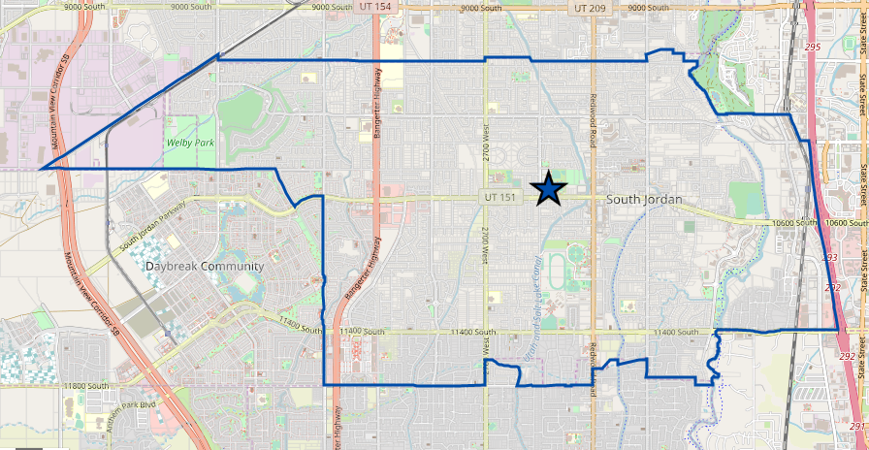
IDI Takeaways – Interview 2
Common Counseling Topics
School: scholarships, career goals, classes taken in high school, cost, program wanted - lay out the options and resources
Major: students think they need to work where you can make the most money – they aren’t open to all types of careers
Pathways Understanding and Definition
Give the students more of a career focus
Take all the classes in the content area that will help a student become proficient in that area
Pathways Evaluation
Really beneficial for some students – it will give them more “hope”
Liked the focus on transferring to a four-year university – right now it only refers to entering the workforce
Idea/Message Evaluation
Liked all “proactive” actions by the advisors or university so students receive the help they need at the beginning
Liked allowing students to try things out
Area of study was broader than a major or degree
Tools and Resources
Clarification on what the eight areas of study look like and a description of the majors that are in the area of study
Electronic description either in an app or website for the majority of the information, but have a paper/pamphlet to give students
High school covered | Bingham CTE - Jordan School District
Years as a counselor
Heard of Pathways before? | Yes
Length of interview | 32 min
Overall view of Pathways | Positive
Key Takeaways
Transferring to a four-year university is an attractive aspect to counselors, but the Pathways model is currently seen as strictly vocational
The eight areas of study are not intuitive to counselors, and they want very detailed information to be provided
Key Quotes
“It gives kids more of a career focus. If you want to go into a trade school, take these classes to go down that pathway. Take all the content areas that will help you become proficient in the area”
“I think it will give students a log more hope that they don’t have to take many classes before they can start into what they want to do”

Slide 74
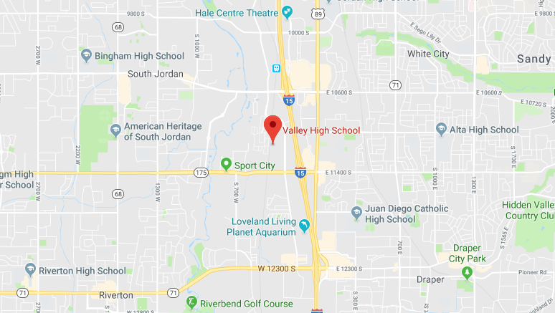
IDI Takeaways – Interview 3
Common Counseling Topics
School: based on what the student wants to do, a financial check, an interest inventory
Major: help students find their interests and understand the decision is not for their whole life
Pathways Understanding and Definition
Pathways is like an apprenticeship program to help students learn skills and gives students a map
Helps students transition from high school to college
Pathways Visual Evaluation
Liked that it was simple
She would use it to describe the process to students who come into her office and are confused about majors
Idea/Message Evaluation
Needs to have a balance between flexibility and structure for students – provide them with a plan and allow them to choose
Don’t force students to do or study something, that is when they drop out
How the Change Affects Her Job
Thought it would make her job more simplified
Would need a description of majors within each area of study
High school covered | Valley – Alternative High School
Years as a counselor
Heard of Pathways before? | Yes
Length of interview | 31 mins
Overall view of Pathways | Positive
Key Takeaways
Students feel that deciding upon a major or degree is like choosing their job for their entire lives, so choosing an area of study is a daunting task for high school students
Counselors like that the Pathways model is simplified from the current higher education structure
Key Quotes
“Well they always think that [choosing a major] is the answer for the rest of their life”
“I think it makes sense that you get more information into a major. It makes it more simple for students”

Slide 75
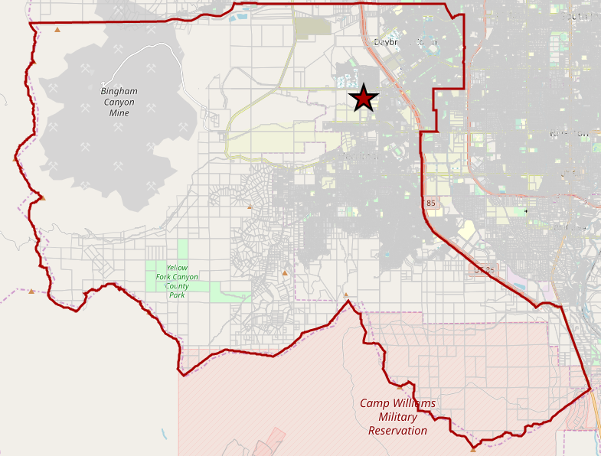
IDI Takeaways – Interview 4
Common Counseling Topics
School: academic performance in high school, finances, major, scholarships
Major: Two thirds have an idea of what they want to do, personal inventories, interests, scholarships, careers
Pathways Understanding and Definition
Set of classes that give you experience in a particular field
Similar to the high school Pathways model at their school
Pathways Visual Evaluation
Thinks the images should be on the right side and students go into them
Have the icons in a straight line – seems like you have to take classes from all of the areas before continuing
Concerns with Pathways
Worried about students who want to switch degrees
Concerned the model makes students choose an area of study right away and locks them into the major or area
Tools and Resources
Graphic or visual that explicitly shows how SLCC is changing
Printed sheet to show students the courses they need to take, scholarship opportunities, and timing
High school covered | Herriman – Jordan School District
Years as a counselor | 2 years
Heard of Pathways before? | Yes
Length of interview | 31 min
Overall view of Pathways | Positive
Key Takeaways
Most kids feel like you have to have a specific major to work in a specific career
Counselors think students should not choose a major or area of study until after they have started college and learn more about what they are interested in
The visual of the Pathways model is an important tool in helping to explain the system, but it needs a few edits to help others understand the details of the change
Key Quotes
“I like that if you follow Pathways, you can have a job or transfer. If kids change their majors, it gives them a safety option. It gives them the skills needed to start a career or continue education”
“I’m worried about when they want to switch the areas of study that they are locked into a specific degree”

Slide 76
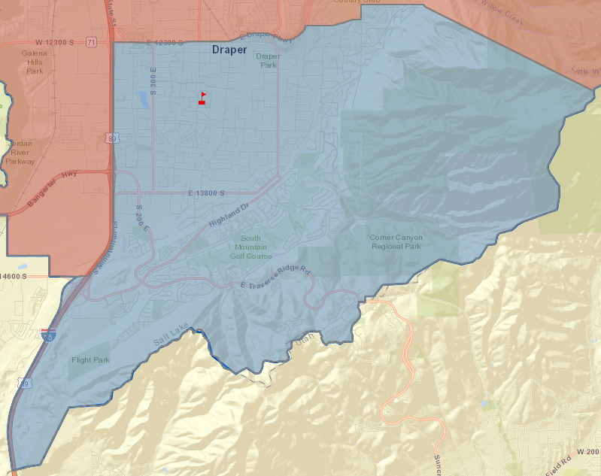
IDI Takeaways – Interview 5
Common Counseling Topics
School: helps students choose a major first then a school, determine interest level with juniors
Major: help give students hands-on experience, based on the student’s interests and goals
Pathways Understanding and Definition
Liked the simplistic path and vision
Proactive advising and extra guidance is what students need
Pathways Visual Evaluation
Liked the visual layout and how it clarifies the model
Wanted examples and additional details of how the model would operate for students
Idea/Message Evaluation
Liked messages that showed proactive and tailored help for each student
Liked giving students options
Concerns Expressed
Worried about students taking ownership of their schooling
Parents pressuring their children too much
High school covered | Corner Canyon – Canyon’s School District
Years as a counselor
Heard of Pathways before? | No
Length of interview | 30 min
Overall view of Pathways | Positive
Key Takeaways
Pathways should take a very proactive role in helping transition students from high school to college
Help provided to students should be individualized and based on the student’s needs and interests
Key Quotes
“Kids are pretty clueless when they leave high school and they don’t know what they want to do. I wish kids got more exposure to help solidify what is out there”
“The things that stick out to me are the simplistic path or vision. I think so many kids get lost in not having a direction. Proactive advising is what this generation needs more than ever before”

Slide 77
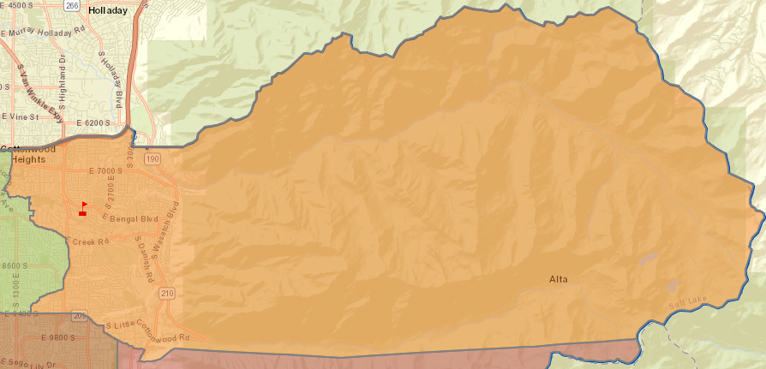
IDI Takeaways – Interview 6
Common Counseling Topics
School: location, finances, academic record, scholarships, program availability, and transferability
Major: interest inventory, student’s career desires, cost
Pathways Understanding and Definition
Similar to the high school pathways outline that helps students reach a technical degree or career
Students believe it is only for vocational professions
Pathways Visual Evaluation
Liked the simplified version/layout of the model
Thought this would be helpful in explaining the model to students
Idea/Message Evaluation
Liked the positive messaging options across each of the pairs
Liked messages that allowed the students to switch areas of study or postpone deciding upon a career or major
Tools and Resources Needed
Map showing the programs or majors available to students and in which area of study they fit
Website showing which credits transfer to various schools
High school covered | Brighton – Canyon’s School District
Years as a counselor
Heard of Pathways before? | Yes
Length of interview
Overall view of Pathways
Key Takeaways
The term “Pathways” primarily gives counselors the perception of the high school vocational program that is in the state of Utah
Positive messaging is better received by counselors
Allowing students to have flexibility and additional time to decide upon a major or area of study is important to high school counselors
Key Quotes
“I could potentially see [Pathways] describing a four-year degree, but for a student, I don’t see them correlating that to their definition. For students, it’s more about technical degrees”
“I think it would be a relief for me because I would need help and this would simplify my choices for me, guide me through the process, and get me to where I was going”

Slide 78
Overall, high school counselors have a good understanding of Pathways. Still, Salt Lake Community College must clarify pathways perceptions to have the best implementation.
Description of Pathways
Counselors: n = 6
Previous Understanding of Pathways
Concentrated program “Pathways is concentrated, so if you want to go into a particular field, you take certain classes” Like the high school pathways “They have this in high school. It’s the steps for students to have the career they want to have in the future and the stepping stones to get to that career” Career focused “The way it is conveyed in high school is that it will be more for a technical degree or career rather than continuing education”
Points to Clarify Regarding Pathways
The model is different from the high school or BYU pathways program Students are still able to create their own class schedules based on their interests No effect on students who know exactly what major to pursue – model is primarily for students who do not know what they want to do The model is primarily for transfer students rather than for vocational purposes
Part of Pathways that Resonates Most
Simple vision “That sounds awesome! The things that stick out to me are the simplistic path or vision. I think so many kids get lost in not having a direction” “If that was me as a student, it would be a relief for me because I would need help and this would simplify my choices for me, guide me through that process, and get me to where I was going” Proactive advising “The proactive advising thing is what this generation needs more than ever before” “I think the goal is, we as counselors need to do a better job to look beyond the immediate four-year or graduate degree. There are many jobs that do not require additional school. This will help that process” Versatility “I like that if you follow Pathways, you can have a job OR transfer. It gives kids safety options”
Q: Have you heard of the Pathways model? If so, how would you describe it?
Q: What part of the description resonates most with you?

Slide 79
High school counselors like the visual of the Pathways model. The content of the areas of study and the intro to the areas sections are the most confusing to counselors.
Pathways Visual Evaluation
Counselors: n = 6
High school counselors want a clear description of the logistics under the Pathways model to help them in their counseling.
Content of the eight areas of study
“So, if I’m just looking at the pictures, the images don’t really tell the person what the areas of study are”
“I like that it has images. The images can relate to a field of study pretty quickly”
Process organization
“I think having them in a circle makes me think I have to do something in all of those areas. I would like them in a straight line down to see the flow”
“I would want to see a clear, step-by-step flow of a student in the process”
First 24 – 32 credits
“Are the first 24 – 32 credits the general electives that all kids take? I would want more examples of what that setup looks like”
“So each year students are put in the same classes like a cohort then?
Major and pre-major
“I think students would be confused at the major or pre-major. I’m a little confused about the purpose of the pre-major and the qualifications from that”
Points to Clarify
Q: What do you like about the visual? What do you wish was different? What is confusing about it?

Slide 80
Switching areas of study, employing quality advisors, and transferability are the primary concerns counselors have. These can be addressed by providing additional information.
Concerns and Effects of Pathways
Counselors: n = 6
Primary Concerns
Switching areas of study “I’m worried about if they want to switch the areas of study and they are locked into a specific degree” “Most kids don’t know what they want to do up front. Making them choose an area worries me” Quality advisors “I think those academic advisors need to better help students. Students feel like the advisors don’t know anything and we lose them at the beginning” Transfer credits “Since the students take courses in high school that get college credit, how does that incorporate into the model?” “Will the pre-major credits all transfer to other universities?”
Overall, high school counselors want more rather than less information regarding the format of Pathways. SLCC needs to offer clear descriptions of the course selection, advising, and transferring processes at the college through primarily online/electronic resources.
Tools/Resources Needed
Areas of study description “We would definitely need more information on the eight areas of study – what they are, the majors included in them, and where they can transfer to” Website or app “I usually give them digital information. We recommend they go to the school website, and I try to walk them through it if I can” “Mostly electronic with a graphic or visual to show how SLCC is shifting. Visually describe the changes in the process” Program offerings “Something showing what programs or what can be completed at SLCC and understanding what students can pre-major in and what they can earn at SLCC” Pamphlet or handout “I like having a printed sheet on a single sheet to be able to show them courses, scholarship opportunities, and courses to take” New Student Orientation “I really feel like at SLCC there should be a week-long class you take prior to school that is all about how to be successful in college and how to meet your academic advisor, how to get a parking pass, how to get help in math, etc. Give them extra orientation for a longer period of time”
Q: What concerns, if any, would you have about the new model?
Q: What tools or resources could the college provide to help address your concerns with the Pathways model?
Q: What about the Pathways model would make your job more difficult as a high school counselor? How would your job be easier if Pathways were implemented at local colleges and universities?

Slide 81
Overall, high school counselors prefer messaging that allows students to have flexibility, and counselors like giving more responsibility to the academic advisors.
Pathways Model Idea Evaluation
Counselors: n = 6
Idea 1 | Idea 2
Advisors provide a default course plan for first-year students “I think the other one leaves them with too many options. This one gives them proactive help in course selection” “I don’t love the default word. It makes you seem like you’re a failure” | Students do not have to decide on their own what courses to take during their first year “I think sometime if courses are selected for them and somebody helps them understand why they are taking those courses, they will stick with them longer”
Students are required to meet with an academic advisor once a semester “I like knowing that they are required to meet with the advisors once a semester to know that it is actually happening” | Academic advisors proactively set up appointments with students once a semester “If you leave it up to them, they won’t do it, but if you have someone calling them, they’ll do it” “I think students would really like the idea that the responsibility is not on them”
Areas of study allow students to easily complete pre-requisites for multiple degrees before deciding on a single degree “I kind of like the first one, because what if I change my degree fully and it’s not similar to the degree I was studying before. This is more helpful” | Similar degrees share pre-requisites so students do not fall behind if they decide to switch their major or degree “This one for sure. I think when kids find out they switched pathways and they find out they have to take five more classes, it can be cumbersome for kids”
Students do not need to decide exactly what to study right away “This one is kind of open ended. It’s like it’s no big deal” “This one is a little less scary” | Students do not have significant repercussions for switching majors/degrees in their first year of study “Students should have the option to try things out in their first year. They shouldn’t be penalized for that” “If you try to force it, that is when kids drop out”
Students must choose an area of study prior to starting their college classes | Students can choose a major or degree after starting their college classes “I think giving kids choice is good, but also have the flexibility that they aren’t screwed if they want to switch. I think kids do better with flexibility within the requirements”
High school counselors prefer students having the ability to choose a major or degree after starting their college classes. Clearly defining the difference between “area of study” and “degree or major” will be important for speaking with counselors.
Q: Do you like [Idea 1] or [Idea 2] more?

Slide 82
High school counselors use consistent terminology to define the following terms.
Terminology Understanding
Counselors: n = 6
Term | Description of Findings |  | Implications for Messaging
Degree vs. Major vs. Certificate | Certifications are specialized, degrees are broad, majors are areas of emphasis | “Certification is just something they are going to get some training for. A degree is within a major” “A degree is the all encompassing education and their area of specialization at the college. A certification is a one to two year program that gives them the specialization needed for a job” “A certification is like a license to get a specialized job. A degree is like a broad stepping stone toward a career. You major in a certain area that you specialize in and put a lot of classes toward. | “Certification” will convey a specific focus while “degree” will be more broad
Transfer Degree | Completing an associate degree is considered the same as a transfer degree | “Finish an associates in that area and transfer to a four-year university to get a bachelor’s” “Only degree that we transfer is an associates, otherwise it is just transferring credits” “I tell students to get a completed associates degree” | “Transfer Degree” is synonymous with “Associates Degree”
General Studies | Broad courses that are required that give you knowledge of many areas of study | “It’s the same kind of courses that you took in high school at a college level to demonstrate competency” “Something everyone has to take. Gen ed requirements” “It’s a wide variety of classes that help them to be knowledgeable in a wide range of fields that give them exposure to a variety of things. I use it to help students choose careers” “Classes that are required that don’t necessarily go toward your major. Students just say ‘generals’” | Use “Generals” to describe the multi-disciplinary required courses that students take during their studies
Workforce Program | High school counselors do not know about the workforce program | “I don’t know much about their workforce program” “I honestly don’t know much about it” “I don’t know what you mean by that” “I don’t know what that is” | Better market and describe the Workforce program
Academic Plan | Plan for courses that students need to take in college | “Someone is going to sit down with them or they will do on their own to from point a to point b to get them out of college” “All of the courses a student needs to take to graduate” “Their major requirements including their general requirements. Maybe even a map to complete classes” | “Academic Plan” should only describe courses required for graduation
Area of Study | Broad term that describes a subject and has sub categories | “Broad major. One step up from a major” “Where their focus is. I think area of study is the overlaying subject” “Within an area of study, you can choose what you specialize in” | “Area of study” should remain a broad term
Q: How would you describe the following terms?

Slide 83
Program availability, student finances, and high school academic performance play the greatest role in high school counselors college advisement process.
High School Counseling Topics
Counselors: n = 6
Choosing a School
Choosing a Major
Programs available
“You need to make sure that a student’s interests are in line with the opportunities at that school”
High school academics
“We look at their GPA and ACT scores to find the chances of them getting admitted”
Financial situation
“The cost of the school, that student’s ability to pay for the education with family contribution or FAFSA”
“Cost is a big deal. With the prices going up each year, it will sometimes sway kids to choose another school”
“Students want to know how much it’s going to cost them and how much they are going to give them”
Student’s progression
“I’m going to get to know them, find out how they are doing academically, and base recommendations off their interests”
School location
“Depending on if the student wants to live at home or if they want to move out of the house”
Student preferences
“A lot of kids come to me with an idea about what major they want to pursue. If they don’t know, we talk about their interests, things they may be good at, and a personal inventory test”
“Most of the time I’m just guiding them and giving them the options they are looking for”
“For me, it’s about laying out all the options. I’m just giving them the resources to choose for themselves”
Future career opportunities
“Kids have such a hard time deciding on a major because they always think that it is the answer for the rest of their life. They don’t think they can switch careers”
“Some kids have an idea about what job they want work in, but they don’t know much more”
Parental occupations
“I try and ask them what their parents do and if they could see themselves doing what their parents do an loving it”
Q: What factors or attributes matter most to you when helping students decide on a college or university to attend?
Q: What factors or attributes do you consider when helping students decide upon a major, degree, or certificate program?

Slide 84
Aaron Andersen, Partner
Cameron Hansen, Engagement Manager
aandersen@cicerogroup.com
801-456-6743
chansen@cicerogroup.com
801-456-6789

Slide 85
Agenda
4 | Background, Objectives, and Methodology
7 | Executive Summary and Strategic Recommendations
21 | QUANTITATIVE INSIGHTS – STUDENT SURVEY
 | Academic Terminology Used
 | Student Decision-Making Process
 | College Attribute Importance
 | Introduction to Pathways
 | Pathways at SLCC
60 | QUALITATIVE INSIGHTS
 | Parent Focus Groups
 | High School Counselor Interviews
86 | Appendix

Slide 86
Survey respondents showed the following demographic profile.
df | Prospective | Traditional | Non-Traditional
County Breakdown | SLC: 67% Other: 33% | SLC: 74% Other: 26% | SLC: 74% Other: 26%
Male Students
Age | 77% Between 16-20 years old | 99% Between 18-24 years old | 68% Between 25-39 years old
Part of Ethnic Group
Married Individuals
Employment | 44% - Employed part-time 15% - Employed full-time | 47% - Employed part-time 36% - Employed full-time | 21% - Employed part-time 57% - Employed full-time
Plan to transfer to Bachelor’s after Associate degree | NA
Household Income | 46% - $20k - $74.9k | 51% - $20k - $74.9k | 55% - $20k - $74.9k
36%
41%
40%
23%
25%
24%
8%
14%
45%
77%
71%
n = 203
n = 318
n = 337

Slide 87
Students are interested in knowing how long it will take them to graduate and how they will make an academic plan.
Questions to Answer about Pathways
Prospective: n = 203; Traditional: n = 318; Non-traditional: n = 337
Total
Prospective
Traditional
Non-Traditional
Total
Ranking Top 3
n = 334
n = 206
n = 314
n = 161
n = 181
Prospective
n = 65
n = 50
n = 70
n = 41
n = 53
Traditional
n = 123
n = 72
n = 127
n = 59
n = 62
Non-traditional
n = 146
n = 84
n = 117
n = 61
n = 66
Q33: Considering only the list below, what are the top three questions you would like answered based on the previous description of the Pathways model?

Slide 88
Understanding what happens if they don’t know what they want to study and what happens if they switch their area of study are the top questions students want answered.
Questions to Answer about Pathways, Cont’d
Prospective: n = 203; Traditional: n = 318; Non-traditional: n = 337
Total
Prospective
Traditional
Non-Traditional
Total
Ranking Top 3
n = 310
n = 282
n = 84
n = 340
n = 350
Prospective
n = 83
n = 56
n = 22
n = 73
n = 94
Traditional
n = 109
n = 107
n = 35
n = 136
n = 119
Non-traditional
n = 118
n = 119
n = 27
n = 131
n = 137
Q33: Considering only the list below, what are the top three questions you would like answered based on the previous description of the Pathways model?

Slide 89
Across all student segments, passion for the topic is the most important factor for selecting a career or major and area of interest and salary projections follow.
Factors When Choosing a Career or Major
Prospective: n = 203; Traditional: n = 318; Non-traditional: n = 337
Total
Prospective
Traditional
Non-Traditional
Total
Ranking Top 3
n = 631
n = 514
n = 513
n = 457
n = 213
n = 183
n = 36
n = 27
Prospective
n = 160
n = 137
n = 113
n = 82
n = 49
n = 46
n = 9
n = 13
Traditional
n = 244
n = 74
n = 199
n = 165
n = 79
n = 71
n = 13
n = 9
Non-traditional
n = 227
n = 203
n = 201
n = 210
n = 85
n = 66
n = 14
n = 5
Q20: Considering only the list below, what are the top three factors that matter to you when you are choosing a career and major?

Slide 90
It is difficult to find a major that aligns with interests and passions as well as something that makes substantial income.
Difficulties of Choosing Major, Degree or Certification
Prospective: n = 203; Traditional: n = 318; Non-traditional: n = 337
Total
Prospective
Traditional
Non-Traditional
Total
Ranking Top 3
n = 321
n = 272
n = 260
n = 257
n = 254
n = 213
n = 213
Prospective
n = 75
n = 65
n = 57
n = 59
n = 67
n = 57
n = 37
Traditional
n = 118
n = 102
n = 91
n = 97
n = 88
n = 79
n = 81
Non-traditional
n = 128
n = 105
n = 112
n = 101
n = 99
n = 77
n = 95
Q21: Considering only the list below, what are the top three most difficult parts of choosing a major, degree, or certification?

Slide 91
Opinions of family members and an ability to transfer the major are not important for students.
Difficulties of Choosing Major, Degree or Certification
Prospective: n = 203; Traditional: n = 318; Non-traditional: n = 337
Total
Prospective
Traditional
Non-Traditional
Total
Ranking Top 3
n = 212
n = 182
n = 180
n = 105
n = 52
n = 52
Prospective
n = 57
n = 38
n = 44
n = 20
n = 14
n = 19
Traditional
n = 77
n = 67
n = 80
n = 28
n = 23
n = 19
Non-traditional
n = 78
n = 77
n = 56
n = 57
n = 16
n = 14
Q21: Considering only the list below, what are the top three most difficult parts of choosing a major, degree, or certification?

Slide 92
Most students are interested in understanding salary projections as well as the requirements for being accepted into a career or major.
Information for Making Decisions on Career or Major
Prospective: n = 203; Traditional: n = 318; Non-traditional: n = 337
Total
Prospective
Traditional
Non-Traditional
Total
Ranking Top 3
n = 365
n = 311
n = 293
n = 291
n = 240
n = 199
Prospective
n = 94
n = 71
n = 71
n = 85
n = 37
n = 55
Traditional
n = 148
n = 109
n = 99
n = 104
n = 92
n = 75
Non-traditional
n = 123
n = 131
n = 123
n = 102
n = 111
n = 69
Q22: Considering only the list below, what are the top three kinds of information or tools that would help you make a decision on a career or major?

Slide 93
Again, students are not concerned with how their majors will transfer. Most students are less concerned with job placement as well.
Information for Making Decisions on Career or Major
Prospective: n = 203; Traditional: n = 318; Non-traditional: n = 337
Total
Prospective
Traditional
Non-Traditional
Total
Ranking Top 3
n = 193
n = 187
n = 155
n = 148
n = 144
Prospective
n = 44
n = 45
n = 37
n = 27
n = 34
Traditional
n = 78
n = 59
n = 45
n = 65
n = 57
Non-traditional
n = 71
n = 83
n = 73
n = 56
n = 53
Q22: Considering only the list below, what are the top three kinds of information or tools that would help you make a decision on a career or major?

Slide 94
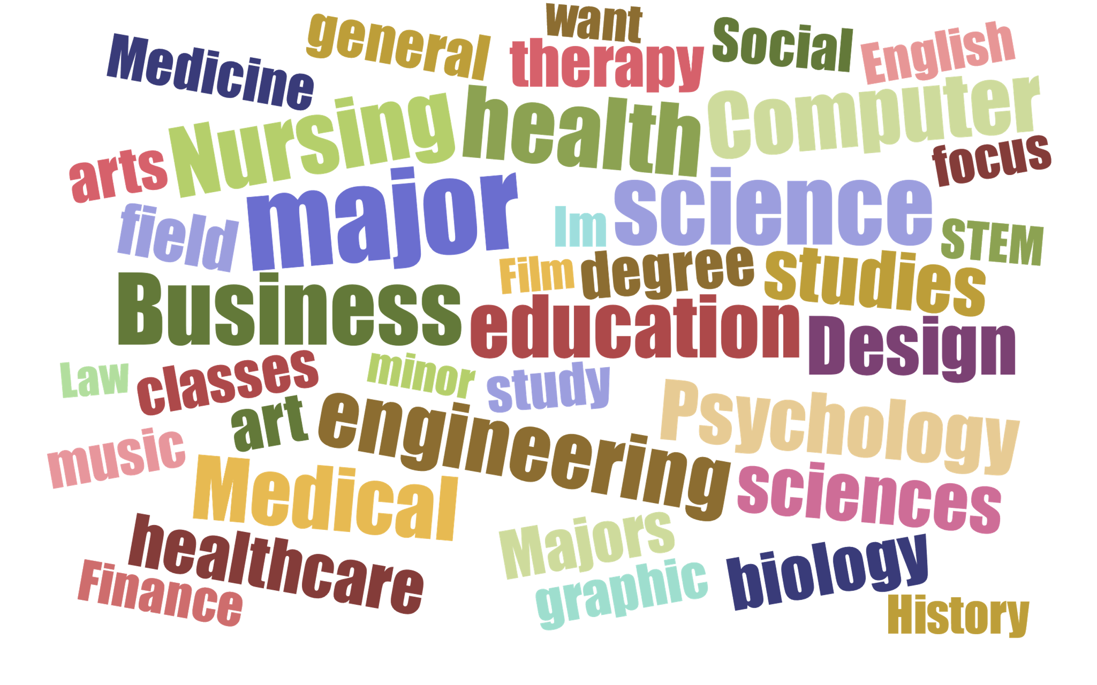
Students described specific subject areas of collegiate study with words major and minor. Many simply use their specific field of study to answer the same question.
Words to Describe Specific Subjects in College
Prospective: n = 203; Traditional: n = 318; Non-traditional: n = 337
Q11: What is the best term to describe the specific subject area(s) you want to focus on in college?

Slide 95
The term “undecided” remains the most commonly used term when aiding students with alternate answer choices
Deciding Majors
Prospective Traditional: n = 203; Current Traditional: n = 318; Current Non-traditional: n = 337
Prospective Traditional
Current Traditional
Current Non-Traditional
All student groups said they used the term “undecided” in both the unaided and the aided question types. This is the term that resonates most with students.
By Segment
Q10: Again, assume you are a student in college who has not decided which degree or certification to pursue in your studies. Which of the terms below would you most likely use to complete the following sentence: “I am ___________.”

