Slide 1
America To Go

Slide 2
Overview of America To Go
Purpose of America To Go (ATG)
SLCCBuy Punch-out catalog for catering purchases
Manage the catering contracts
Single payment vendor

Slide 3
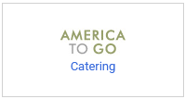
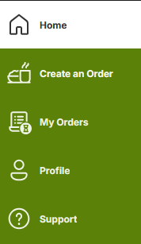
Start an Order
Log in to SLCCBuy
Click on the America To Go punch-out sticker
Click on Create an Order

Slide 4
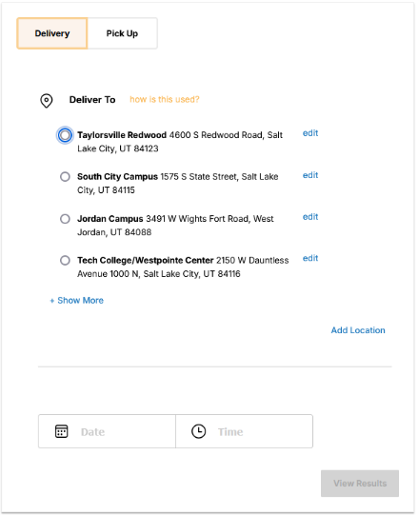
Location and Date
Select Delivery or Pick Up.
Next select the location.
Next enter the date and time.
Lastly, click the View Results button.

Slide 5
Restaurant Search Results
Search Results Based on Location
Default view shows caterers delivering to your location
Filter results using options on the left side
Some restaurants listed twice due to different menus
To view more information about a caterer, click on their name.
To view their menu, click the Menu button.

Slide 6
Menu Categories and Ordering
Menu Categories and Items
Categories listed on the left side
Items within a category appear to the right
Search Functionality
Search bar at the top of each menu
Printing the Menu
Click the print view link on the upper right side
Ordering
Click on item name to show ordering options
Special Instructions

Slide 7
Adding Items to Order
Items will be listed on the right side
If you cannot see your order on the right side, click the Cart icon.
Any errors will be displayed at the top.
You must remedy any errors before you can proceed.
Once you have added all of the needed items and fulfilled all of the requirements, click the Proceed to Checkout button

Slide 8
Checkout Process
Verify Order Summary
Ensure all information is correct
Enter Delivery Instructions
Favorite?
Click Submit Order button if everything is correct

Slide 9
SLCCBuy Checkout
Complete Checkout in SLCCBuy
ATG order will be in your SLCCBuy cart
Enter Index and Account number 70455
Enter business purpose in notes
Attach attendee list if applicable
Business purpose should align with Small Dollar Purchase Guidelines
Refer to SLCCBuy Manual for requisition instructions

Slide 10
Timing
Departmental Review and Approval
Ensure sufficient time for review and approval
Caterer Preparation and Delivery
Standard lead times provided for each caterer
Order Confirmation
America To Go emails confirmation to PO Owner
Confirmation sent once caterer accepts the order

Slide 11
One Caterer per Order
Items from different caterers cannot be mixed in one ATG order

Slide 12
Editing an Order Before Approval
Editing Draft Cart
Shoppers can modify items in a draft cart
Click MODIFY ITEMS

Slide 13
Changing an Order After Approval
Call America To Go’s 24/7 Customer Care line at (866) 284-8646
No need to request a Change Order on the PO
Additions handled during invoice payment

Slide 14
Special Requests and Custom Orders
Creating Custom Orders
Contact the caterer directly to create a custom order
Inform the caterer about uploading the order into ATG
Requesting a Quote
Coordinate event details and request a quote
Quote should include food, delivery/service fee, service ware, and staffing
Uploading the Quote
Caterer emails the quote to you
Forward the quote to customerservice@americatogo.com
Must be the individual who will enter the order in SLCCBuy.
Placing the Order
Receive an email with details on placing the order in Punch-out

Slide 15
Non-Catering Food Orders
Exceptions
Order less than $2500 paid with a p-card
No setup, service, or cleanup included
Food will be picked-up or delivered
Granted by Gina Chase
Must adhere to Small Dollar Purchase Guidelines

Slide 16
How do new vendors register with America to Go?
Vendors can contact America to Go at (866) ATG-TOGO or email them at customerservice@americatogo.com.

Slide 17
How does the caterer get paid?
You should not receive an invoice from the caterer.
If you do, do not submit it.
The caterer should send their invoice to America to Go.
America to Go sends their invoices electronically directly into SLCCBuy.
America to Go will issue payment.
ATG processes payments between the 5th and 10th of every month for all events that occurred and were invoiced in the previous month.

Slide 18
Conclusion
Questions?
Contact: Gina Chase

