Slide 1
Emburse Enterpise
Formally Chrome River

Slide 2
Delegate
Set a delegate in Account Settings
Email Lisa Bradshaw or Bryan Christensen

Slide 3
Expense Report Names
P-Card Expense Report
Travel Expense Report

Slide 4
T-Number
Last 7 digits of the Pre-Approval ID
Proceeded by a “T”

Slide 5
Expense Types/Account Codes

Slide 6
Receipt vs Pcard Transaction

Slide 7
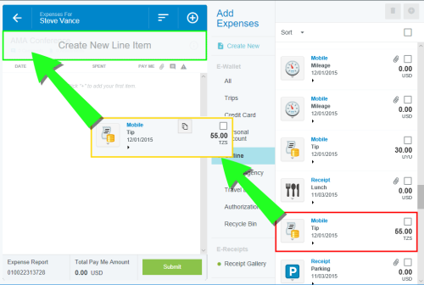
Drag and Drop

Slide 8
Mobile Apps
Will be phased out during 2025
New Emburse Enterprise App

Slide 9
Email Receipts
To: receipt@ca1.chromeriver.com
From: Must be work email
Subject: Amount (0.00) OR email of user

Slide 10
Receipt Quality

Slide 11
Returned Reports

Slide 12
Where to attach a receipt

Slide 13
Questions

