Slide 1
Purchasing Training

Slide 2
Department Purpose
The Purchasing & Accounts Payable (P&AP) department includes Purchasing, Purchasing Card, Accounts Payable, and Travel. Our department is responsible for overseeing and processing the procurement and payment of supplies, services, and construction.
Getting the goods and services you need while complying with laws, regulations, and policies.

Slide 3
Purchasing Assistance
Purchasing provides help with:
Saving your department money
Sourcing assistance
Purchasing expertise and experience
Creating efficiencies
Upholding College policies and procedures

Slide 4
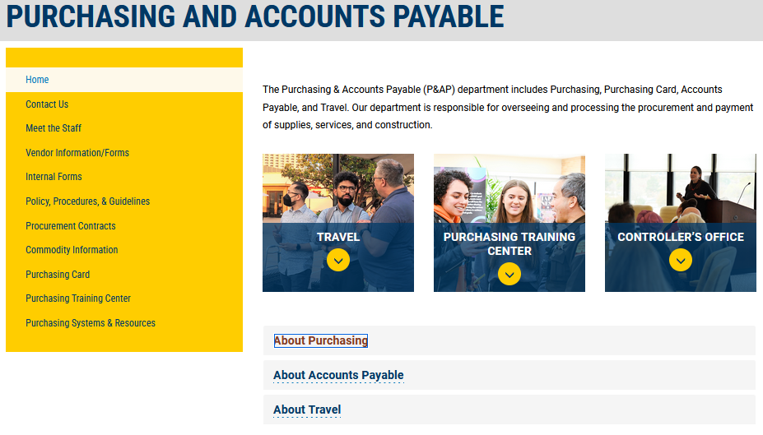

Slide 5
Governing Laws, Rules, and Policies
Federal Procurement Rules
State Procurement Code
USHE Policy
College Policies
College Rules and Guidelines

Slide 6
Campus Standards
Computers and Software
Printers
Furniture
Construction/Room Changes
Printing Services and Promotional Items
Catering
Notes:
Dell & HP
Define Catering

Slide 7
Inappropriate Expenditures
Personal expenses of any kind
Donations
Alcoholic beverages
Loans
Political contributions

Slide 8
Thresholds
Small-Dollar Purchase Threshold
$2,500
P-Card Preferred
Small-Dollar Bid Threshold (Informal Bid Process)
$5,000
$50,000 (Construction/Pro Services/Software)
Large-Dollar Bid Threshold (Formal Bid Process)
$50,000
$100,000 (Construction/Pro Services/Software)
Notes:
State Contract/College Contract
P-Card is the most efficient and preferred method for small-dollar purchases – exceptions SW, Furniture, Computers
Small $ - one bid
Large $ - two or more bids
Software requires additional approvals by OIT

Slide 9
Payment Requests Exceptions
Payment Requests may be used for the following:
Expenditures under the small dollar purchase threshold of $2,500
Memberships
Subscriptions
Conference Registrations
Placement advertising in magazines, journals, newspapers, radio, television, online, buses, billboards, etc.
Library journals, periodicals, and rare books
Broadcasting rights, television programming, and associated fees
Grant pass-through payments
Payments to other government entities
Royalties
Maintenance agreements approved by Purchasing
Contract payments after the initial PO has expired (e.g., year 2 of a multi-year contract)
Simple Service Contracts (See Simple Service Contract Guidelines)
Other payments as determined by Purchasing
Notes:
Used when the vendor does not accept a P-Card!
Memberships, Subscriptions, Conf Reg online payment required – Brian can increase single transaction limit for that payment, decrease after payment has been made

Slide 10
Purchasing Card
Preferred for small-dollar purchases.
Must upload receipts in Chrome River
Must reconcile expenses in Chrome River monthly
Notes:
Training with Brian

Slide 11
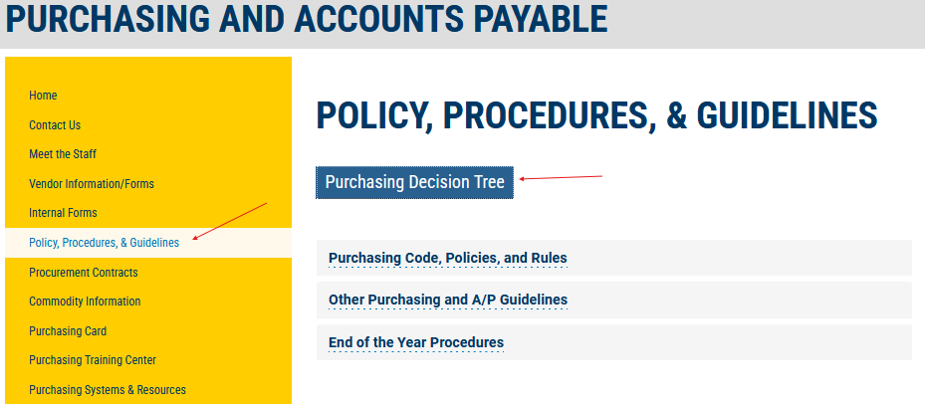
Purchasing Decision Tree
Notes:
Great info to have at your fingertips!

Slide 12
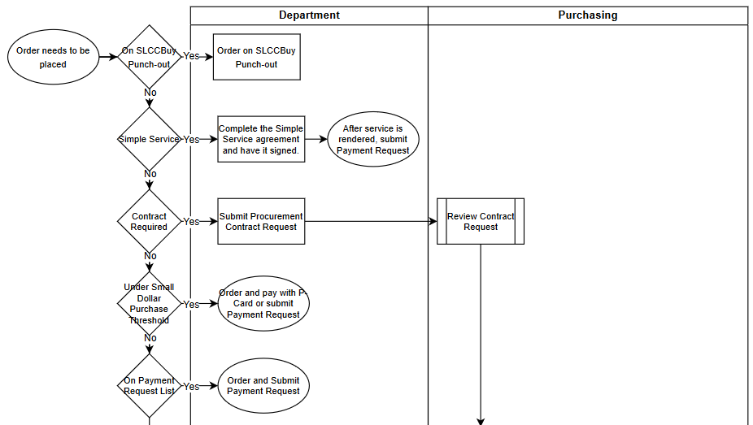
Purchasing Decision Tree
Notes:
Dept/PCH

Slide 13
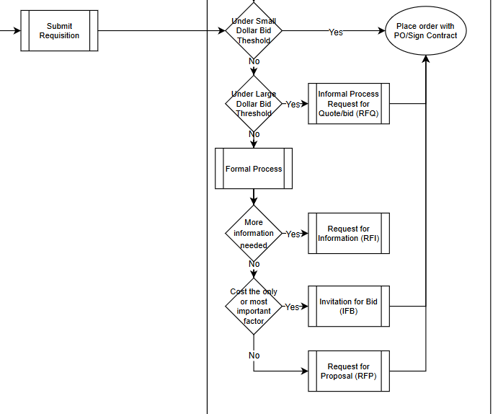
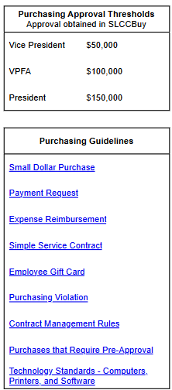
Purchasing Decision Tree
Notes:
Thresholds/Links

Slide 14
Types of Orders
P-card
Payment Request
Punch-Out
Non-catalog
Procurement
Contract

Slide 15
Required Approvals
Vice Presidents must approve:
all expenditures for $50,000 and above.
VPFA must approve:
all expenditures for $100,000 and above.
The President must approve:
all expenditures for $150,000 and above.

Slide 16
Quote/Bid Process
Requests for Quotes (RFQs)
Over $5,000, equal or less than $50,000.
Sent to three (3) or more known vendors.
May be completed by the department with purchasing approval
Upload copies of quotes received
Invitations for Bids (IFBs)
Over $50,000.
Posted online
Minimum of 7 days
Must be completed by Purchasing
Include specs in Requisition

Slide 17
Request for Proposals (RFP)
Used when criteria other than cost must be considered
Complete the RFP Questionnaire
Evaluation Committee

Slide 18
Cooperative Purchasing Contracts
Competition (Bid/RFP) not required if the product/service can be purchased off a recognized cooperative contract
Utah State Contracts
NASPO
OMNIA
E&I
Sourcewell
USHE/UEN
Other

Slide 19
Sole Source Procurement
Sole source procurement may be used when a requirement is only reasonably available from a single supplier
Availability
Compatibility
Transition costs
Require justification
Sole Source Justification Form
Not reasons: price, time

Slide 20
Procurement Contracts
A procurement contract is any contract that includes the expenditure of funds.
All procurement contracts, except Simple Service Contracts, must be submitted unsigned in SLCCBuy using the Procurement Contract Request Form.

Slide 21
Simple Service Contract
The simple service contract form may be used for services that meet the following criteria.
Contract is in compliance with the Simple Service Contract Guidelines
Contractor must be an individual, not a company, nor an employee of SLCC
Total Cost is under the small dollar purchase limit
Only one payment will be made
Service must be low risk, such as guest lecturers, performers (no equipment), note takers, models, and photographers
Complete form and have it signed before service is performed
After service is completed, submit form as Payment Request

Slide 22
Receiving
If products are delivered by the Receiving Dept., no reporting is necessary.
If products are delivered directly to department by vendor or picked up, send proof of delivery to the Receiving Dept.
If service, send confirmation of services rendered to the Receiving Dept.
Receiving is not required on Standing POs.
Contact the Receiving Dept. via e-mail.

Slide 23
Invoicing
Under $2500, No PO, non-contract
Submit as Payment Request
PO was created
Submit using PO Invoice form
Over $2500, No PO or contract
Submit Purchasing Violation Form

Slide 24
Prepayments
Not allowed
Exceptions determined by Purchasing
Deposits
Progress Payments

Slide 25
Violations
An unauthorized purchase is a purchase made without following the authorized procurement processes.
An after-the-fact purchase occurs when a College employee places an order without first completing a requisition and receiving a purchase order.

Slide 26
Violations – cont.
Result in duplicate payments to the vendor, for which the department is responsible.
Result in higher costs for goods and services
Lead to significant vendor payment issues that can result in problems for other departments on campus.
Bypass the appropriate approval process.
Place the College at financial risk and create potential personal liability.
Create additional, often unnecessary, work for administrative support staff.

Slide 27
What to do if a violation occurs:
Complete the Purchasing Violation Form.
An explanation of why policy was not followed
Future corrective action
Attach invoice
The form will be routed to your VP

Slide 28
Ways to Avoid Violations:
If you have to place an order, create the requisition right away.
You must arrange a payment method BEFORE placing an order.
“I didn’t know…,” is not a valid excuse for violating policy.
“If you don’t know what the appropriate procurement method is, don’t guess. Reach out to us first!”

Slide 29
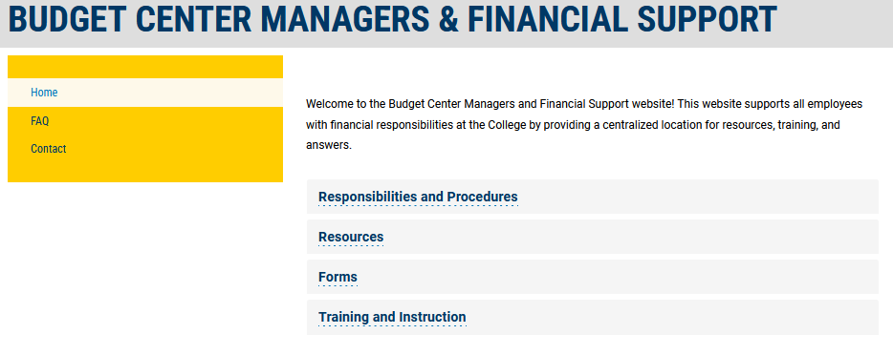
BCM Website
https://i.slcc.edu/budget-center-manager

Slide 30
Thank You for Participating
If you have questions, please call Purchasing at 4254 or e-mail purchoff@slcc.edu

